Slide 1


Teachers’ perspective: What ICT Competence and Professional Development do we need?
Hans Laugesen

Slide 2
Goals for use of ICT
Train students in use of modern technology
  Digital competence 1 of 8 EU key competences
Train new competences
  Collect information, be critical, project work
  Social and civic competences plus initiative and
  entrepreneurship are also EU key competences
Learn more in the subjects
  No evidence in ELFE or in Handbook on Informa-
  tion Technology in Primary and Sec. Education


÷
Notes:
2

Slide 3
UNESCO ICT Competence Framework
Constitute a common core syllabus
  Defining various ICT competence skills for teachers
Provide a basic set of qualifications that allows teachers to integrate ICT into their teaching
Extend teachers’ professional development

Slide 4
Jef Moonen, Twente Univeritet
Curriculum perspective
Conclusion from anlysis in Handbook on
Information Technology in Primary and Sec. Education:
In most countries there is a successful introduction of ICT in schools following a logical sequence of events: initiating a policy, providing technical ICT infrastructure, teacher training
The sequence of events continues to the infusing phase and to the aspiration for pedagogical and curricular change as well as content development
However the use of ICT as a pedagogical tool in subject areas is not a major success:
Transformation toward a change of the educational structures, including new teaching/learning
processes, is not yet occurring.

Slide 5
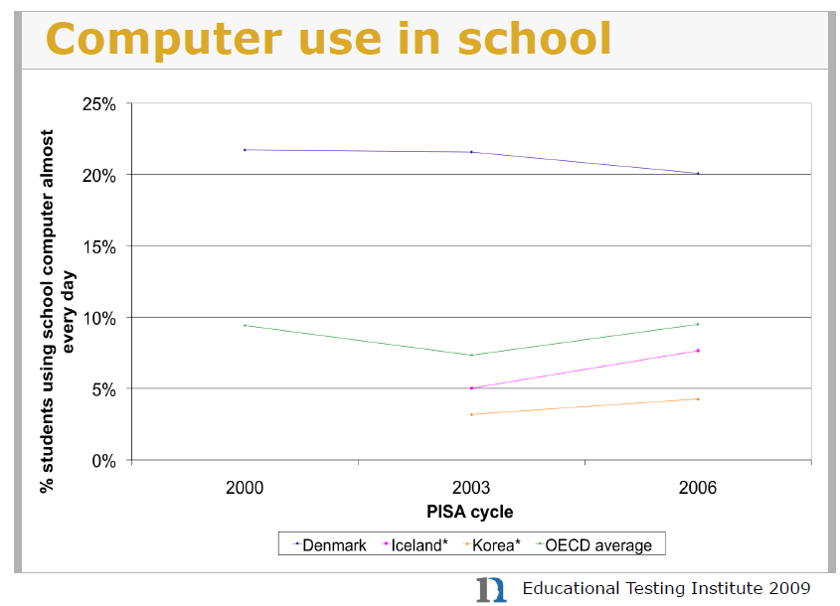
PISA CBAS 2006 Júlíus K. Björnsson

Slide 6
Key factors for use of ICT when teaching
Available technology in the classroom
  Many options: Pc, projector, wifi, pda, mobiles
Technological and pedagogical ICT support
Curriculum requirements and new exams
Politicians should not only focus on PISA results in reading, math and science
School management must support an ICT strategy
If teachers are required to use ICT they must be trained to do so
  Best training: give each teacher a PC

Slide 7
OECD’s TALIS 2008
Teachers’ professional development needs

Slide 8
ICT teacher training in Denmark
1980’ies: 30 hours on technical use
1990’ies: 40 hours on subject oriented use
2000’es: Pedagogical ICT driver licence
- used as European model in EPICT
All negotiated with GL and with substantial pilot-teacher involvement

Slide 9
EPICT: structure
Virtual training with
team-work and net-based counselling
3 mandatory and 5 elective modules
Module assignments produced in teams
  Focus on a teaching project
Total time consumption for teachers: 100 h
Typical compensation 50 h + pers. Computer
Accomplished by 80+ % of primary/lower sec. teachers and 55+ % of upper sec. teachers

Slide 10
Uganda’s ELATE
Program on E-Learning & Teacher Education
Teacher Education as a Driver for Educational Development in Africa
Stakeholder involvement in projects
Adapting projects to local circumstances

Slide 11
Aims of Uganda’s ELATE
Explore the use of ICT to raise the effectiveness of trainee and practising teachers in the classroom
Develop a dissemination strategy – that will work within teacher training as well as for teachers in schools
Evaluate and refine materials produced and stimulate wider research on the role of ICT in education
Ensure sustainability by embedding the work in Teacher
Training Programmes and a “Centre for E-Learning” responsible for ongoing development

Slide 12
ELATE’s ICT context
Access to ICT is limited in schools, and on-line access is rare
However, teachers are increasingly able to access computers:
  In Internet cafés and offices.
  In those schools that have computer suites
  (Using CD-ROMs and memory sticks, if not on line).
  Trainees have access in training colleges and universities
  Many teachers already use e-mail to share materials
ELATE has chosen to use ICT to provide direct support to teachers
Focus on “e-Delivery” of Open Educational Resources rather than “e-Learning”!

Slide 13

Recommendation to teachers
Be open-minded for pedagogical changes
experiment with new tools
Require the necessary time to think and reflect and require a margin for innovation trial and error
Make the most of blended learning where you mix traditional teaching with ICT
Add ICT-based visual and emotional stimuli to the learning process and be aware to include all students
Consider how ICT can be used to create contacts between classes at different schools and countries
Participate in professional development and in teacher networks and follow innovative developments

Slide 14
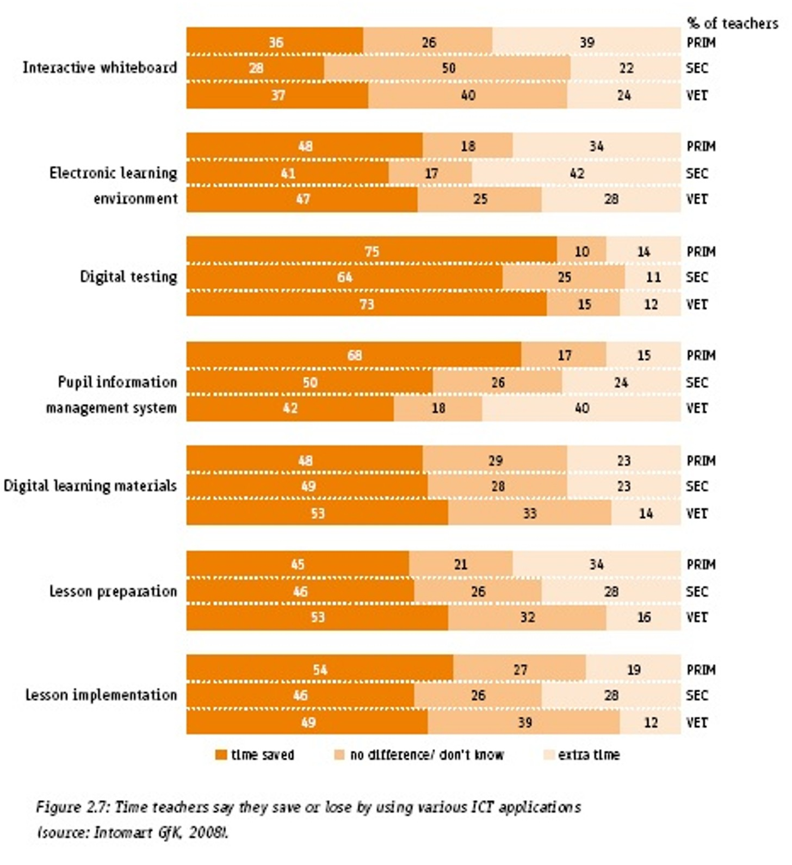
Do you save or waste time using ICT?
Source Intomart GfK, 2008, who asked Duch teachers on their opinion
Time
consumer
Time-
savers

Slide 15
Need for pedagogical research
Use of ICT does not take place at the cost of traditional subject learning
Good results training 21. Century Competences
But we need more research and exchange of good examples on the pedagogical use of ICT to increase the learning outcome in subject knowledge

Slide 16
Rec. to teacher educ. Institutions
(and in-service training providers)
Integrate training in pedagogical use of ICT in teacher education
Establish partnerships between teacher education institutions and schools to strengthen the pedagogical use of ICT.
Focus more on research in the pedagogical use of ICT
Pedagogical use of ICT is the most relevant use

Slide 17
Competence standards for teachers
All must be able to make pedagogical meaningful use of ICT when teaching
Standards must reflect both the global challenge and national priorities
Requirements to teachers use of ICT must be followed by relevant training
Government must
  Ensure pedagogical use of ICT is included in initial teacher training
  Support research and allow room for trial and error at school level
  Requirement to use ICT must be reflected in subject curricula and exam requirements

Slide 18
How to make ambition meet reality?
In ICT CST implementation guidelines teachers must be able to meet 62 different objectives…
In addition to master subject requirements and other cross curriculum requirements…
Only possible to combine if integrated in initial teacher education
62 objectives cannot be mastered after a few days of in-service training
Training should give inspiration, but daily practising with room for trial and error is essential
And do not require teachers to master a pedagogical implementation no-one knows how to do right

