Slide 1
Ageing and the teaching profession
January 21, 2011
1st World Women’s Conference
Bangkok
Facilitator: Ilze Trapenciere

Slide 2
Plan of the workshop
What is aging?
When does it start? Whom does it concern?
Demographical changes and the ageing labour force
Is ageing workforce regarded as a high profile problem?
Does ageing include wisdom perspective? (silver color)
Ageing and some aspects of the quality of life
Should there be a state ageing policy?
Should there be Union Ageing Policy developed?
What perspectives should the Ageing policy include?

Slide 3
What is aging?
Two decades - political debate, research and development of the public opinion
The ageing process concerns children, youth, middle generation and it should be analyzed in relation to other periods of life.
3 groups – seniors, middle generation and youth. From shared responsibility to competition and even conflicts. Intergenerational solidarity.
The concept “senior”, older person, emphasizes that ageing is a life long process that includes biological, physical, psychological and social changes.
Old age - it does not start with retirement, person can be active for decades.
Classification (4 groups, Koskinnen, 1998)

Slide 4
Ageing society
Society is regarded as aged or ageing society if more than 7% of the population is older than 65.
It is a dominating tendency in some countries (EU, Australia).
The younger generation decreases from 31% to 27% by 2015. The number of population is decreasing before 2015 in the EU (Walker A.)
The older generation (65+ ) essentially increases in the EU.
Cohort 80+ reaches 9% by 2020 (in comparsion to 3.9% in 1995).
The average age of population reaches 44-50
This tendency will continue for at least 2 decades.
That means that an effective social (ageing) policy is necessary.

Slide 5
Is ageing workforce regarded as a high profile problem?
Actors involved in the issue include:
- Government;
NGOs that represent older people,
research organisations and media,
Social partners – employers’ representatives and trade unions – have been only marginally interested at the national level.

Slide 6
Ageing policy (LV)
Family and environment
Health care and social welfare
Education, cultural activities and sports
NGOs
Regional and international colaboration

Slide 7
Workforce
EU, Australia, USA – workforce ageing, faster than the general population (3,5 yrs f/t, 5,6 yrs F f/t). Reasons (education, female employment).
Ageing in education sector. Average age is the highest among the sectors (43.4:38.6 yrs).
Most rapidly greying sector (on average 2.8yrs older , in education +5.2yrs).
OECD study: teachers 50+ (10-20 % Korea, Pt, Au), 24-27% - UK, Sw, 31-35% NZ, No, F, Nl; 39+% Se, It, De
USA (SASS study) curve with two peaks - young and old teachers

Slide 8
Consequences, problems
The economical consequences are difficult to predict because older workers in the future may not have the same characteristics as older workers today.
The ageing of the workforce could slow down economic growth performance.
LF participation rates fall after age 54, therefore older forkforce have lower average rate of participation.
Supply problems in future as an increasing number of teachers reach retirement age.
Unless older teachers can be persuaded to stay in the LF, labour shortages could occur resulting in increased pressure on wages.
Risk of diminuition in the quantity and quality of services.
Cost implications for school budgets (USA study) and state pension systems

Slide 9
Health and health risks
Illnesses related to ageing in general (the most frequent chronic conditions – hypertension 26%, artritis 24%, respiratory diseases 20%,
Occupational diseases (back, voice, burn out, psychological problems)
Risks for teachers of particular subjects (PE)
Service pensions. Early retirement pensions?
Pros and contras? Does you country has the service pension system for teachers?

Slide 10
Retirement and financial security
Retirement age for teachers in the EU varies from 55 to 70.
Very different pension schemes
What is the retirement age at your country and what are the main characteristics of pension scheme for teacers that other Unions could learn from?

Slide 11
Your experience
Does your country has an ageing policy?
What are the main features of that policy?
Does your Union has an ageing policy?
The main features of that policy?
Is it necessary to develop a Union ageing policy?

Slide 12
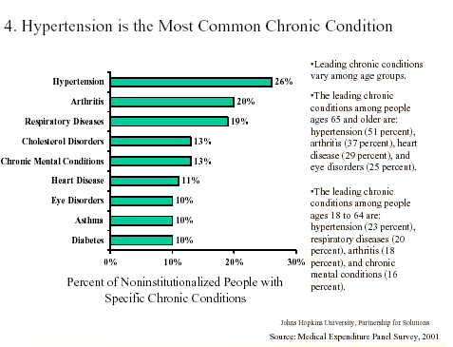
Notes:
What are the most frequent chronic conditions?
Chronic conditions are conditions that cannot be cured – we need to manage them. Require a totally different kind of HC.
IF needed, who gives most of the support for older people?

Slide 13
Care of family members
Taking care of older family members
(Walker) increasing female employment is a factor that decrease the possibility of family care because factors because mainly woemn are the care takers of the elderly.

Slide 14
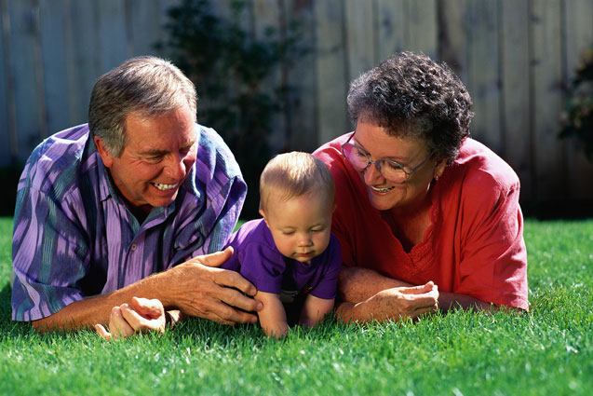
Quality of life and leisure
Life satisfaction
Life long learning
Activities - cultural, physical, entertainment...

