Slide 1
Confronting the crisis
EI Workshop, Accra, 8 Feb 2012

Slide 2
Confronting the Crisis
Defusing a social time bomb
Investing in schools and teachers
Delivering high quality education services
Building unity
Preparing for a Global Action Day on 5 October 2013

Slide 3
Defusing a social time bomb
Jobs, Jobs, Jobs
Sustainable Demand and Decent Work
Financial Regulation
Fair and Progressive Taxation
Climate Action

Slide 4
Investing in schools and teachers
Reaching EFA targets by
focusing on:
Girls’ Education,
Early Childhood Education,
Vocatonal Education
Improving teachers’ education, terms and employment conditions

Slide 5
Key agencies
G8/20
OECD
World Bank
UNESCO
Global Partnership for Education
The Gordon Brown initiative: Global Fund for Education

Slide 6
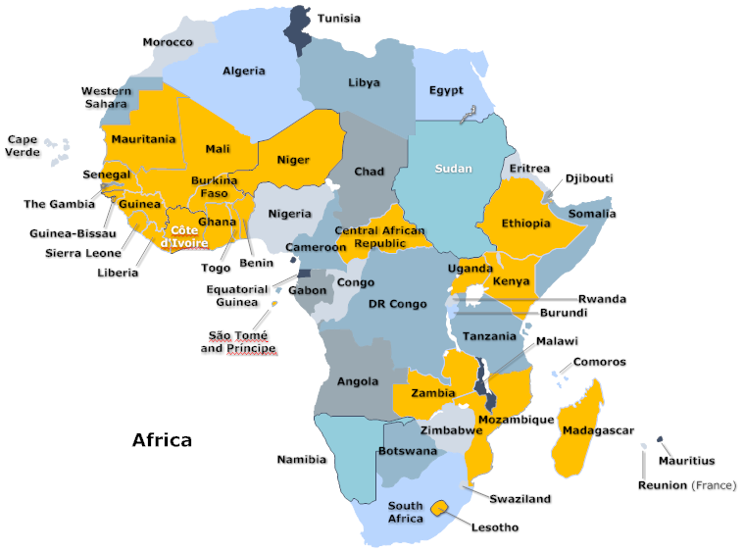
26 GPE Countries in Africa

Slide 7
Delivering high quality education services (and fighting de-professionalization)
Raising our Professional Standards
Engaging in Teachers Education and Professional Development
EI programs:
Quality Educators For All
Global Network on Excellence in Teaching

Slide 8
Building unity
EI National Commissions on the Status of Teachers and Professional Standards
Global Action Day 5 October 2013

Slide 9
PRIORITY 1:
Protecting schools against the effects of the debt and economic crises
PRIORITY 2:
Countering de-professionalization trends
PRIORITY 3:
Confronting attacks on education unions
PRIORITY 4:
Pursuing the rights and equality agenda
PRIORITY 5:
Strengthening EI membership

Slide 10
ACTION TOOLS
PROGRAM 2012
Priority 1-5
Campaigns 115,800
Advocacy 100,500
Research 96,500
Information 276,200
Assistance 111,500
Capacity Building
540,500

Slide 11
MEMBERSHIP PARTICIPATION MECHANISMS
Conferences 130,000
Networks 65,000
Taskforces 50,000

Slide 12
26 GPE Countries in Africa

