Slide 1
It ain’t all work no play Raising awareness for Trade Union Issues
Notes:
Lärarförbundet, the Swedish Teachers Union, Sweden’s largest professional trade union that represent over 233 0000 teachers and school heads in schools, preschools and leisure-time centres.
Lärarförbundet is independent in party-political terms.
On an average day I work mainly with soliciting new members to our organization but before I did this I used to work as a project manager for the #likeaswede project at TCO, Lärarförbundets federation.
The next twenty minutes I will talk about how TCO changed the way young policy professionals view the Swedish industrial relations system. And hopefully give you some insights about the challenges, results and how we got there.

Slide 2
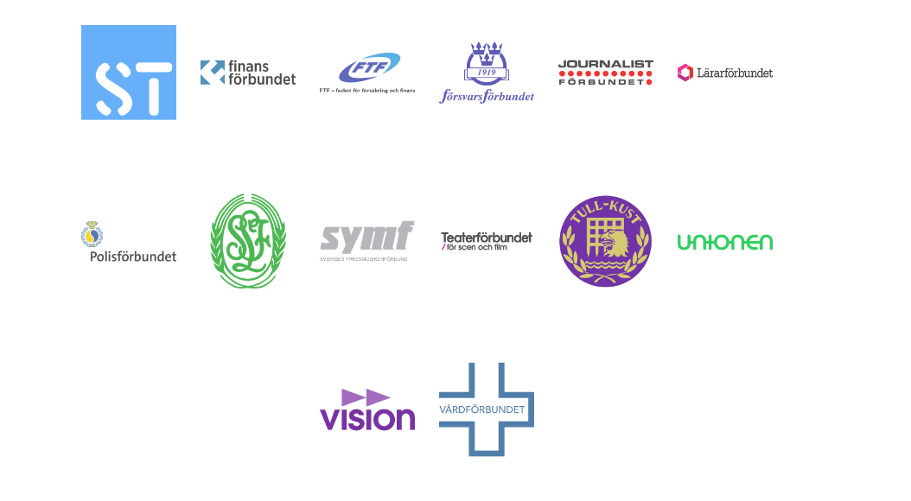
This is TCO
TCO is a federation of 14 different white collar trade unions in Sweden
TCO –affiliates organises around 1,3 million employees
TCO stands free without any connections to any other party political or religious interest
Notes:
TCO (The Swedish Confederation of Professional Employees) comprises 14 affiliated trade unions.
The 1.3 million members of these unions are professional and qualified employees who share a major responsibility for important functions in society, although in a wide variety of occupations. They work in all parts of the labour market, for example in the schools, healthcare, trade, the media, the police, industry, IT and telecom. Over 60 percent of the members are women. Approximately half of the members work in the private sector and half in the public sector.
TCO is also independent in party-political terms.

Slide 3
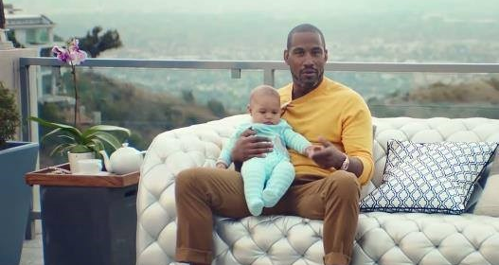
Like a Swede
Notes:
https://www.youtube.com/watch?v=hJ_qHiGo754&t=14s

Slide 4
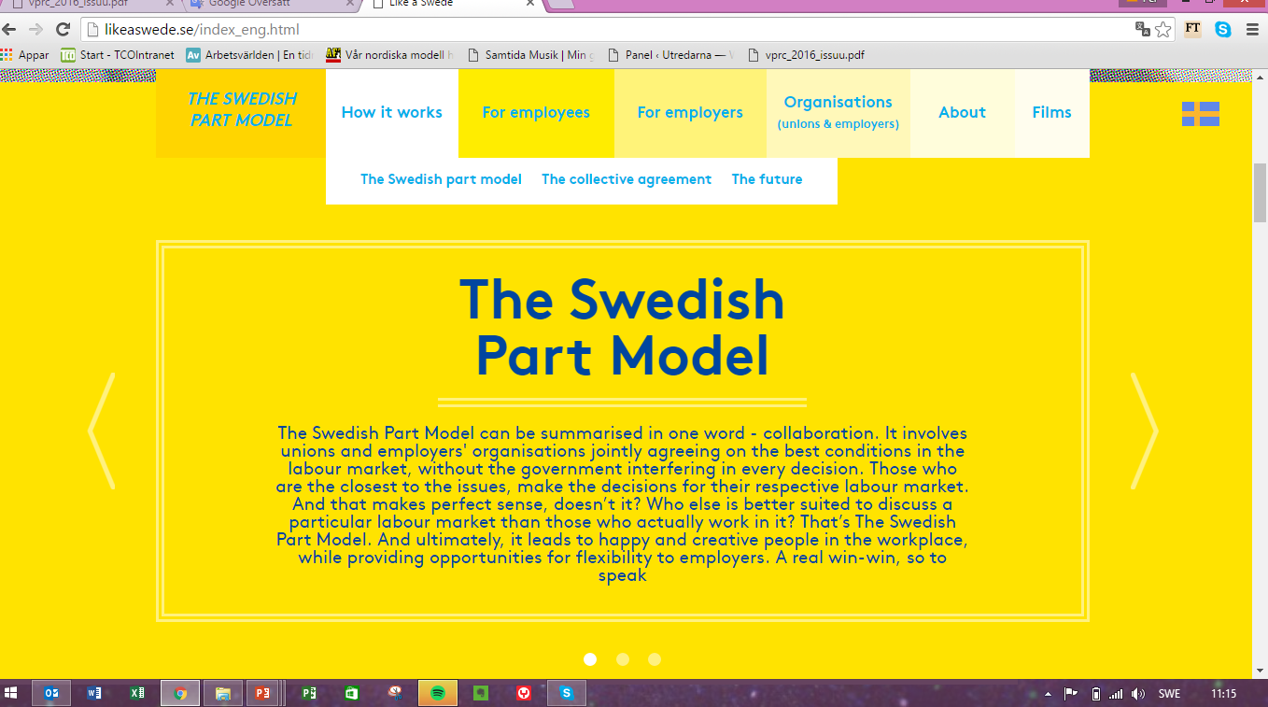
Notes:
The collective agreement constitutes a large part of The Swedish Part Model. It is a result of the important negotiations that take place between unions and employers' organisations and can include agreements on salaries, employer pension, insurances, annual leave days and much more. The agreement applies for both the employer and the employees during a certain number of years and is in that period binding and covers all employees in a workplace whether you are a union member or not. During the period all industrial action is forbidden for the parties.

Slide 5
Why?
Notes:
Why was there a need for the film you just saw?
In 2007 Swedish unions had a big drop in member numbers due to increased unemployment fees by the government. This crisis made the TCO affiliates take a closer look at them selves instead of just blaming the government for losing members. What they saw was that they had been quite bad at communicating the value of a membership and the idea of unions in general. With these insights they started a project called FacketFörändras.nu – that translates to The Union is changing now. With a target group consisting of young professionals between the ages om 20 and 35. The purpose being taking a closer look on what we offered as unions and how we communicated toward non affiliated.
The answer we got was that young professionals hade low to NO knowledge about the labour market system in which the Swedish unions operate.

Slide 6
Among young professionals…
…ignorant toward the concept of trade unions and the Swedish part model
Found the trade unions membership fee to high
Are prejudice of what trade unions are and do
Notes:
Like a swede was the grand finale of FacketFörändras.nu and the beginning of something new.
Why do i say that it was the grand finale? Well we build the campaing on the same problems – or rather the campaing wanted to solve the problems that had been pin pointed when the work with facketförändras.nu started.
Young professionals were
…ignorant toward the concept of trade unions and the Swedish part model (they didn’t quite know what we did)
Found the trade unions membership fee to high
Are prejudice of what trade unions are and do (they thought that a membership wasnt for them)

Slide 7
Task
Communicate the Swedish part model to young policy officers. (TCO Executive Committee 15 April 2013)
”The mission is to promote a coherent story of the value of the Swedish part model where strong trade unions are core.” (From the general action plan TCO 10 June 2013)

Slide 8
Finding the right story for our message
Talk talk talk talk talk talk talk talk talk talk talk talk talk
Talk talk talk talk talk talk talk talk talk talk talk talk talk
Talk talk talk talk talk talk talk talk talk talk talk talk talk
Talk talk talk talk talk talk talk talk talk talk talk talk talk
Talk talk talk talk talk talk talk talk talk talk talk talk talk
Notes:
We wanted to change tha way we communicated the swedish partmodel and realised that to do just that we had to collect other opionons than ours.
So we talked. And talked. And talked.
We talked to young professionals, we talked with random people on the street, we talked to entrepeneurs and bussiness leaders.

Slide 9
and…
TESTS
Notes:
And after talking and choosing a tone for the campaign we thought it be a good idea to actually test it before going live.
Before going further and filming we tested the script in focus groups to see wether we were on to something or if we should change idea completely.
Luckily for us it turned out good and we went on producing what came to be one of swedens most shared ads!

Slide 10
Strategy
2nd
1st
Notes:
We built our strategy on the way swedes relate to things swedish when seen from an outside perspective. Swedes are genrelly not that eager to brag about Sweden or talk about the swedish labour market exept from when Swedes go abroad. As soon as we leave Sweden we love to talk, perhaps even brag, about how we have an extended parental leave and often more than the legislated days of vacation. Two years ago the NY times wrote an articel about parental leave after having visitied Sweden and Stockholm – that article was a viral success – people loved that the NY TIMES were writing about swedish parental leave. It was as if we have been approved och seen by the cool kids in class.
The task was to to adress and initate a stronger relationship with young policy makers. But considering that this is an extremly well courted target group we soon realised that we had to reach these young policy makers through their followers - young professionals. If we could produce content so interesting and shared by young professionalls that these youn policy makers saw it as something happening that they couldnt not comment or share – then we would be homefree!

Slide 11
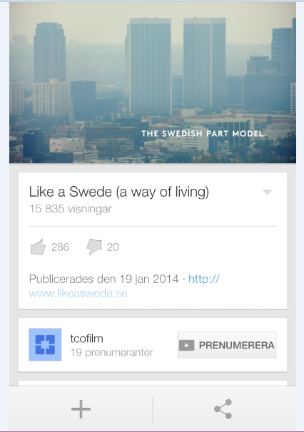
Results

Slide 12
It takes two to tango…
Notes:
After evalutaing the first campaign we saw that there was one part lacking in the first film – and that was the swedish unions counterpart - the employers were no were to be seen.
That is how Business like a Swede came to see the light.
Lets take a look on how we portrayed them!

Slide 13
Business like a Swede
Notes:
https://www.youtube.com/watch?v=1YX7h8qNu7g

Slide 14
Parts of the campaign
The film
Tests b4 & after
likeaswede.se
Relation F99M
Notes:
Like before the campaing consisted of the film, a webbsite, tests before and after but this time the campaign grew - adding the cirkel of F99M where TCO started a list of the most influntial policy officers under the age of 35 and invite them in to an event. This gave the listed ”youngsters” the opporitunity to indulge in some humble brag where they on social media could say that TCO hade listed them as influntial and important. By doing so they lifted the campaign and TCO as well as relation themselves and their brand to TCOs.

Slide 15
Business Like a Swede
Big impact in social media
Increased knowledge about the swedish part model
People like to humble brag
Notes:
Business Like a Swede had a big impact in social media. The trailer was shown more than 2000 times and the film itself was showns more than 740 000 time on youtube. It reactualised the first film – giving like a swede an additional 140 000 views giving it more than 900 000 views by this point.
The evaluations said that the knowledge about the swedish industrial model had increased, with a small increase in likeability towards the swedish industrial model.
The aim was to make the young policy officers ambassadeurs of Business like a swede and do it by humble brag about themselves and through that talking about the model and the film – an aim which suceeded.
The event where the 100 most influental under the age of 35 generated 680 tweets from 282 accounts under two days with a total of 3281 mentions in social media.

Slide 16
Thank you!
Ana Esteban, Marketing Manager, Lärarförbundet ana.esteban@lararforbundet.se
+46 72 240 63 08

