Slide 2
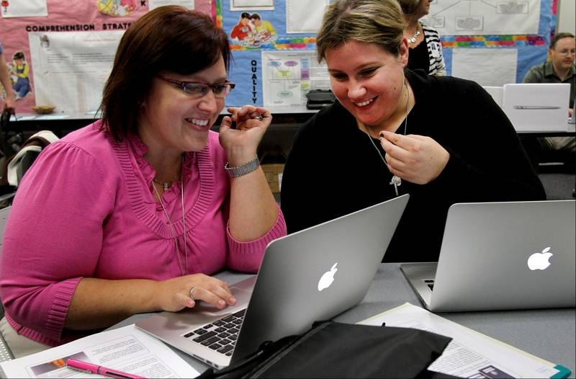
Present situation
ICTs and globalisation are changing the ways educators collaborate, receive info and engage

Slide 3
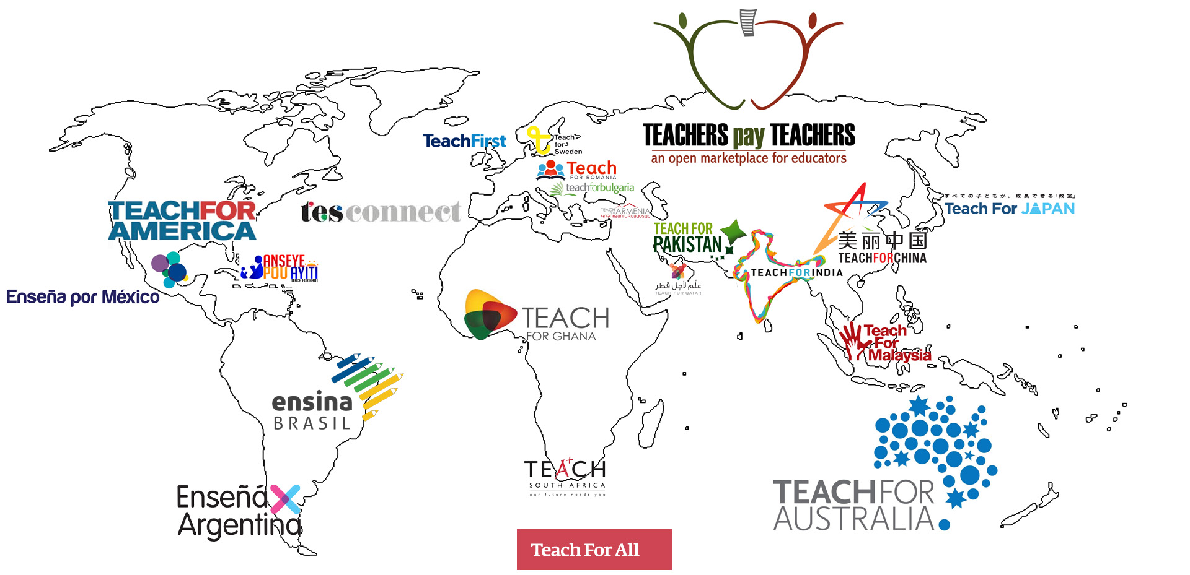
Present situation
The private sector is already taking the space to follow its principal aims: to exploit, to make profit…

Slide 4
Present situation
Education International affiliates already have network. They add value for their members.

Slide 5
Present situation
But all these networks are taking place in walled-off spaces

Slide 6
We propose to work only with partners that share our values and add value to the networks you already have
TENGLOBAL
Project
EI proposes to interconnect partners that share our values and add value to the networks you already have

Slide 7
TENGlobal
Project
Would be a solution enabling EI affiliates to become gateways for their members to become part of the global conversation

Slide 8
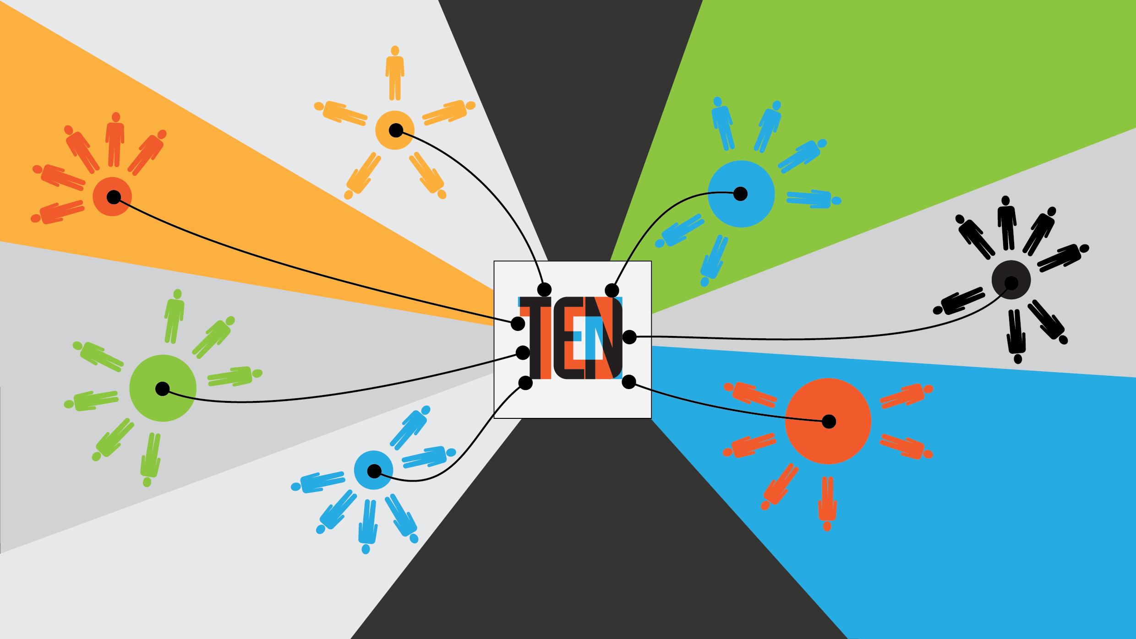
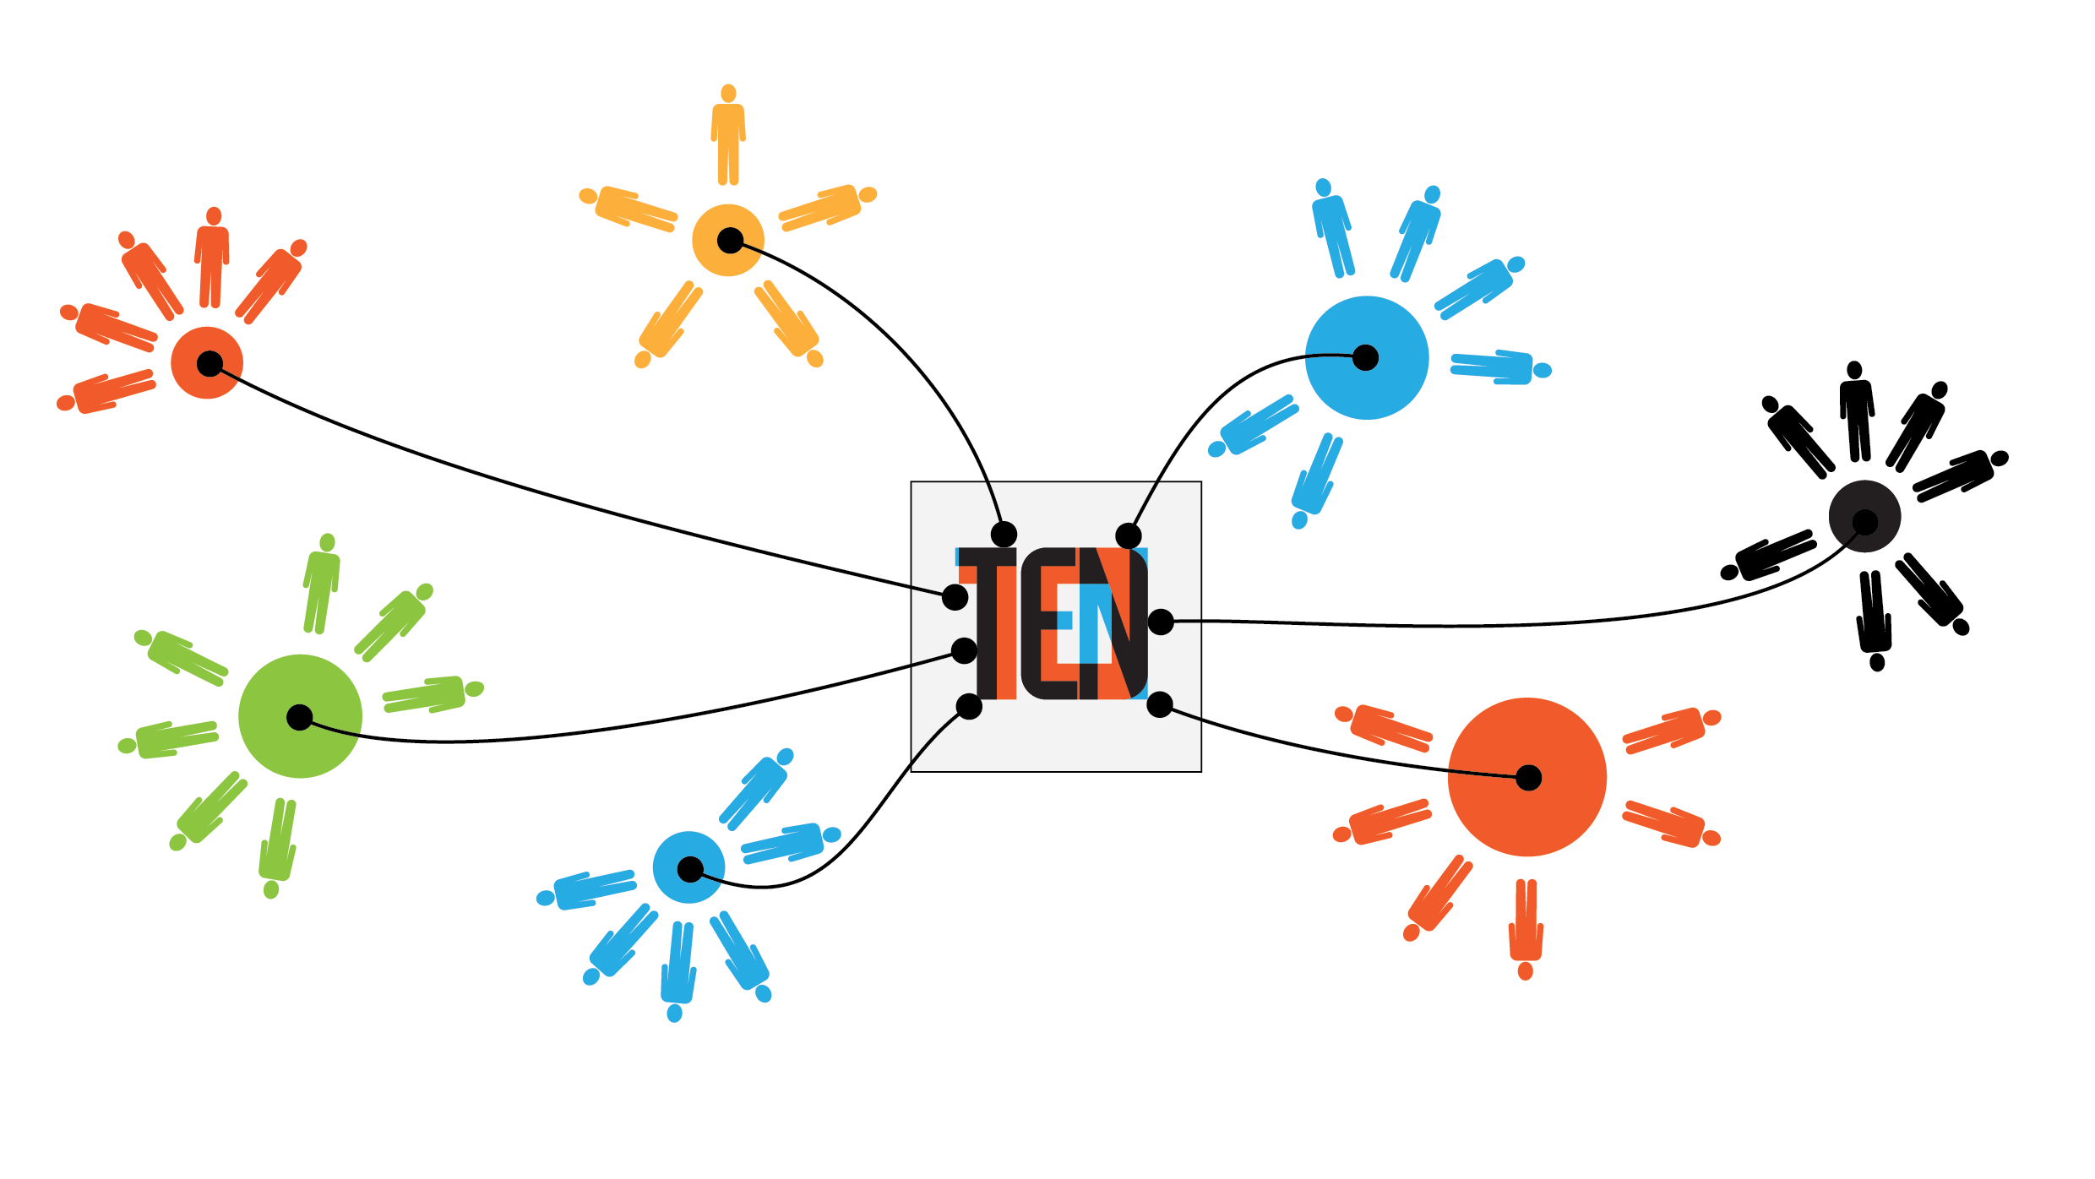
TENGlobal
Project
How
will
it
Operate?

Slide 9
TENGlobal
Project
What value will you get from TENglobal?
Better understand your existing members interests
Possibly attract new members
Possibly re-activate union interest to existing members
Possibly activate new supporters
Promote union values through projects and actions
Open gateways and build bridges for member organisations and new partners
In a nutshell: Instead of your members going elsewhere to connect, share and learn, they will see YOU as their gateway to global learning opportunities

