Slide 1
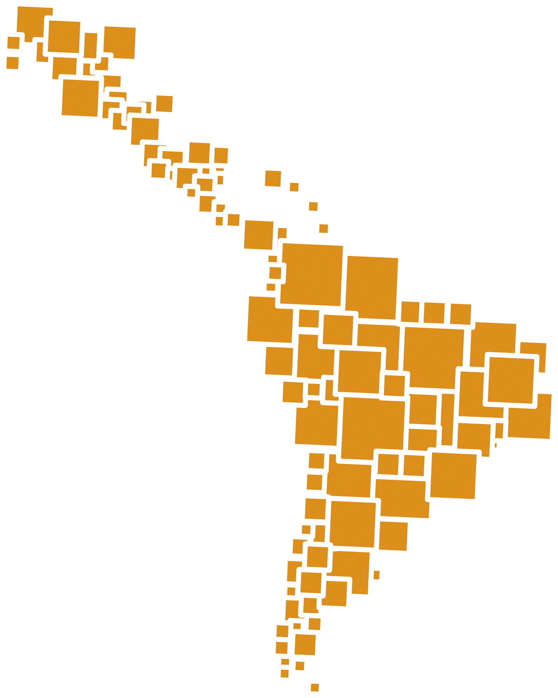
MQE 2013
COMnet, 5th-6th June Brussels

Slide 2
Pedagogic Movement
Started 2011

Slide 3
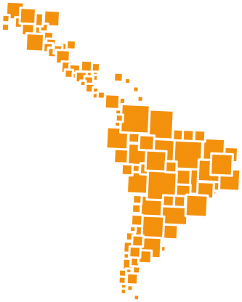
What is it?
Why?
How?

Slide 4
Main issues raised
Public Education-social right-State´s responsibility
Public funding for public policies
Quality?
Valuing teaching profession-Teacher training
Curricula
Alliances -education community
Freedom of association

Slide 5
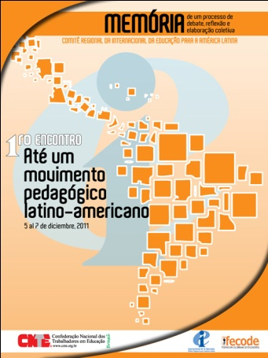
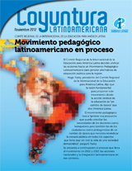
First Materials

Slide 6
HOW?
Subregional encounters 2010 and 2013
Regional encounter 2011and 2013
First publication
Second Publication
Video
Materials available
National meetings 2012 (students, parents, some NGO´s, some mass media)

Slide 7
Pedagogic movement identity

Slide 8
Other strategies
Women network
Higher education
LGBT
Indigenous

Slide 9
Challenge: Cable a tierra

Slide 10
Challenges
Appropiation by unions
Different levels of debate (different union cultures)
Different capacities to impact society (different communication cultures)
Differente capacities to impact public policies and governments

Slide 11
Results
http://www.ei-ie-al.org/index.php?option=com_content&view=article&id=726:documentos-del-movimiento-pedagogico-latinoamericano&catid=100:movimiento-pedagogico&Itemid=58

Slide 12
Muchas Gracias
Oficina Regional
www.ei-ie-al.org

