Slide 1
International Summit on the Teaching Profession
Framing the issues
Andreas Schleicher
Director for Education and Skills
OECD
1
Notes:
Research shows that teachers are the biggest within-school influence on student learning. If we want to raise the achievement of our students, we have to improve teaching through the development and support for professional teacher force.

Slide 2
The kind of things that are easy to teach are now easy to automate, digitize or outsource
Notes:
Half of the jobs in the industrialised world are potentially automatable, because the things that are easy to teach and easy to test are also the things that are easy to automate, digitize and outsource.

Slide 3
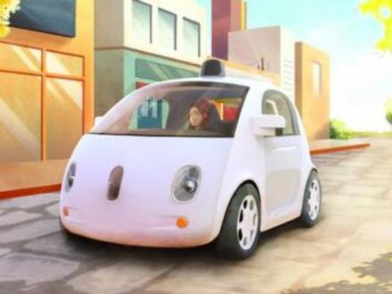
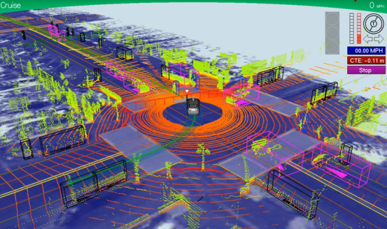
Robotics
The Auto-auto
>1m km,
one minor accident,
occasional human intervention
Notes:
Or robotics. They run whole factories these days.

Slide 4
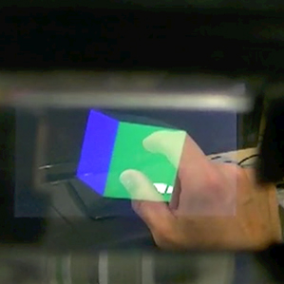
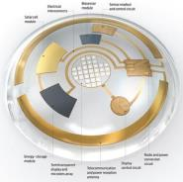
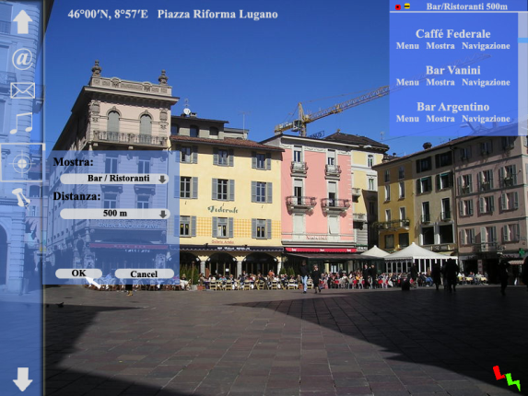
Augmented Reality
Notes:
Or think about augmented reality, the capacity to integrate the world’s knowledge into what we do in real time. The world no longer pays you for what you know – Google knows everything – but for what you can do with what you know.

Slide 5
A lot more to come
3D printing
Synthetic biology
Brain enhancements
Nanomaterials
Etc.
Notes:
And there is a lot more to come.
So what does this mean for education?

Slide 6
Everyone wants to live in your countries
Net migration (in millions of people) into regions, with countries grouped by income level and OECD members, 1960-2010.
Source : OECD (2013), Trends Shaping Education.
Primary source: World Bank (2012), World Databank: Net Migration.
Notes:
Note:
High income countries: are the most developed and the richest counties. They are defined as countries with gross national income (GNI) above $12,000. ( ex.: Germany, France, Chile, Argentina).
Middle income countries: are a diverse group by size, population and income level, and are home to 5 of the world’s 7 billion people and 73% of the world’s poor people (ex.: Brazil, China, India, South Africa).
Low income countries: are sometimes also referred to as developing countries with GNI per capita below $ 1,000. ( ex.: Afghanistan, Uganda, Haiti).

Slide 7
Education in the past

Slide 8
Education now

Slide 9
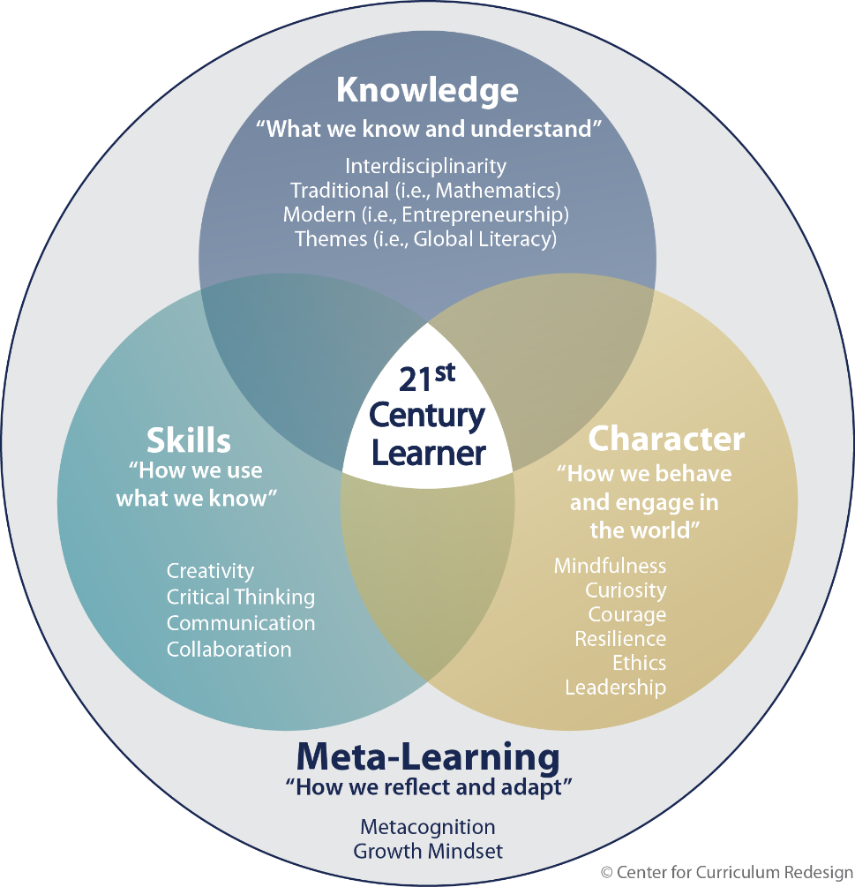
Dimensions of student learning

Slide 10
What knowledge, skills and character qualities do successful teachers require?
Session 1
Notes:
The quality of education can never exceed the quality of teaching and teachers. But what exactly are the knowledge,
skills and character qualities that will make teachers successful? How and to what extent are these related to teachers’
education?
Some people explain poor learning outcomes in their country by claiming that their teachers come from the bottom
third of their college graduates, while high-performing countries recruit their teachers from the top third. Surely, top
school systems pay a great deal of attention to how they select their staff. They work hard to improve the performance of
teachers who are struggling, they provide an environment in which teachers work together to frame good practice, and
they establish intelligent pathways for teachers to grow in their careers. But does all that mean that in those countries the
top third of graduates chose to become teachers rather than lawyers, doctors or engineers?

Slide 11
What knowledge, skills and character qualities do successful teachers require?
96% of teachers: My role as a teacher is to facilitate students own inquiry
Notes:
The quality of education can never exceed the quality of teaching and teachers. But what exactly are the knowledge,
skills and character qualities that will make teachers successful? How and to what extent are these related to teachers’
education?
Some people explain poor learning outcomes in their country by claiming that their teachers come from the bottom
third of their college graduates, while high-performing countries recruit their teachers from the top third. Surely, top
school systems pay a great deal of attention to how they select their staff. They work hard to improve the performance of
teachers who are struggling, they provide an environment in which teachers work together to frame good practice, and
they establish intelligent pathways for teachers to grow in their careers. But does all that mean that in those countries the
top third of graduates chose to become teachers rather than lawyers, doctors or engineers?

Slide 12
What knowledge, skills and character qualities do successful teachers require?
86%: Students learn best by findings solutions on their own
Notes:
The quality of education can never exceed the quality of teaching and teachers. But what exactly are the knowledge,
skills and character qualities that will make teachers successful? How and to what extent are these related to teachers’
education?
Some people explain poor learning outcomes in their country by claiming that their teachers come from the bottom
third of their college graduates, while high-performing countries recruit their teachers from the top third. Surely, top
school systems pay a great deal of attention to how they select their staff. They work hard to improve the performance of
teachers who are struggling, they provide an environment in which teachers work together to frame good practice, and
they establish intelligent pathways for teachers to grow in their careers. But does all that mean that in those countries the
top third of graduates chose to become teachers rather than lawyers, doctors or engineers?

Slide 13
What knowledge, skills and character qualities do successful teachers require?
74%: Thinking and reasoning is more important than curriculum content
Notes:
The quality of education can never exceed the quality of teaching and teachers. But what exactly are the knowledge,
skills and character qualities that will make teachers successful? How and to what extent are these related to teachers’
education?
Some people explain poor learning outcomes in their country by claiming that their teachers come from the bottom
third of their college graduates, while high-performing countries recruit their teachers from the top third. Surely, top
school systems pay a great deal of attention to how they select their staff. They work hard to improve the performance of
teachers who are struggling, they provide an environment in which teachers work together to frame good practice, and
they establish intelligent pathways for teachers to grow in their careers. But does all that mean that in those countries the
top third of graduates chose to become teachers rather than lawyers, doctors or engineers?

Slide 14
Prevalence of memorisation rehearsal, routine exercises, drill and practice and/or repetition
Prevalence of elaboration reasoning, deep learning, intrinsic motivation, critical thinking, creativity, non-routine problems
High
Low
Low
High

Slide 15
Focus on word problems
Fig I.3.1a
Word problems- Formal math situated in a word problem, where it is obvious to students what mathematical knowledge and skills are needed

Slide 16
Focus on conceptual understanding
Fig I.3.1b
Focus on conceptual understanding

Slide 17
Teaching strategies and learning outcomes
Mean
Index
Students below Level 2 have difficulties using basic algorithms, formulae, procedures or conventions to solve problems involving whole numbers
Students at Level 5 and 6 can develop and work with models for complex situations, and work strategically with advanced thinking and reasoning skills
Notes:
OECD average
Results from PISA show that, on average across OECD countries, students who scored at the lower levels of mathematics proficiency, particularly at or below Level 1, most frequently reported that they are exposed to student-oriented, formative-assessment and teacher-directed instruction. Conversely, students who reported greater exposure to cognitive activation instruction scored, on average, at higher levels of proficiency in mathematics, notably at Level 5 or 6.
Before accounting for other teaching strategies, cognitive-activation instruction is associated with an increase of about five score points on the PISA mathematics assessment. After accounting for the other three teaching strategies, the average improvement in mathematics performance associated with cognitive-activation instruction is as large as 19 score points. Remarkably, after accounting for the other teaching strategies, there is a positive association between cognitive-activation instruction and mean mathematics performance in every country and economy that participated in PISA 2012, except Albania.
Results from PISA also show that these teaching strategies are associated with the learning environment and organisation of schools. For example, schools in which these teaching strategies are used more frequently tend to be those with more supportive teachers, where there are good teacher-student relations, where teachers are skilled in managing their classrooms and maintain discipline, and are those whose students reported feeling a greater sense of belonging at school. The strength of the relationship between the learning environment and instructional strategies is greater with teacher directed
and cognitive-activation strategies, and is weaker with student-oriented strategies. Student-oriented instruction is something of an exception in that its relationship with classroom discipline is weak and often negative, most likely because small-group discussions or other methods that aim to give students a more active role in the learning process can generate or require a more dynamic – and, to some, louder – classroom environment.

Slide 18
Professional knowledge and expertise in teaching
Behaviour
Effectiveness is evidenced by teacher behaviour and student learning outcomes
Cognition
Teachers as thoughtful, sentient beings, characterised by intentions, strategies, decisions and reflections
Content
Character
The teachers serve as moral agents, deploying a moral-pedagogical craft
The nature and adequacy of teacher knowledge of the substance of the curriculum being taught
Teacher knowledge of, and sensitivity to, cultural, social and political contexts and the environments of their students.

Slide 19
Second generation immigrant students’ performance in mathematics, by country of origin and destination
The country where migrants go to school matters more than the country where they came from
2nd generation students from
Turkey in:
First generation immigrant students’ performance in mathematics, by country of origin and destination
1st generation students from
Turkey in:

Slide 20
Immigrant students’ performance in mathematics, by country of origin and destination
The country where migrants go to school matters more than the country where they came from
Students from
Arabic-speaking countries in:
Percentage of students with an immigrant background who reported that they feel like they belong at school
Students from
Arabic-speaking countries in:

Slide 21
A continuum of support
21
Make learning central, encourage engagement and responsibility
Be acutely sensitive to individual differences
Provide continual assessment with formative feedback
Be demanding for every student with a high level of cognitive activation
Ensure that students feel valued and included and learning is collaborative

Slide 22
Session 2
What policies can help?

Slide 23
Challenges for teachers
Student-level
Initiating and managing learning processes, including active learning
Responding to the learning needs of individual learners
Classroom level
Emphasising cross-curricular studies
Integrating formative and summative assessment
Integrating students with special needs
School level
Working and planning in teams and partner with other schools
Evaluating and planning for improvement
Using ICT for teaching and administration, etc.
Teaching in multicultural classrooms
Notes:
These are just some of the examples… Society now expects teachers to deal effectively with students of different backgrounds and mother tongues, to be sensitive to culture and gender issues, to promote tolerance and social cohesion, to work with disadvantaged and immigrant students, and with students who have learning or behavioural problems, to use new technologies, and to keep pace with rapidly developing fields of knowledge and approaches to student assessment.
On the school level, also:
Projects between schools and international co-operation. It is becoming more common for schools to collaborate on
joint projects and to develop links with schools in other countries. These programmes require teachers with leadership
and organisational skills, and the capacity to work and communicate effectively in a range of different settings.
• Managing and sharing leadership. In most countries, decision making in schools has become more decentralised in
recent years, especially with regard to the organisation of instruction. An increase in the number and range of decisions
taken at the school level has led to new managerial tasks for teachers; and in some countries teachers are expected
to participate in and contribute to school leadership.
Also on the community level:
Providing professional advice to the parents
Building community partnership for learning

Slide 24
Mean mathematics performance, by school location, after accounting for socio-economic status
Implementing highly effective teacher policy and practice
24
Improve the societal view of teaching as a profession
Recruit top candidates into the profession
Developing Teaching
as a profession
Retain and recognise effective teachers – path for growth
Support teachers in continued development of practice
Notes:
…is really about developing teaching as a profession.
It’s about recruiting talent,
supporting teachers in continued development,
providing differentiated pathways for professional growth,
and reflecting all of that in the societal image of teachers

Slide 25
Teachers’ skills
Numeracy test scores of tertiary graduates and teachers
Numeracy skills of middle half of college graduates
Numeracy score
Notes:
Based on PIAAC, the blue bar shows the middle half of the distribution of numeracy skills of 16-64 year-old tertiary graduates (the end points are the 25th and 75th percentiles of the test scores) and the red segment shows the average nueracy scores of 16-64 year-old teachers (with a 95% confidence interval).
The results show that, among countries with comparable data, there is no country where teachers are in the top third of proficiency in these skills among all college-educated workers; and there is no country where they are among the bottom third of college graduates in these skills. In fact, teachers’ skills in numeracy, literacy and problem solving tend to be similar to those of the average university educated worker. There are just a few exceptions to this general trend: in Japan and Finland, for example, the average teacher has better numeracy skills than the average college graduate while in the Czech Republic, Denmark, Estonia, the Slovak Republic and Sweden, the reverse is true.
There is another way of looking at this. While, in each country, teachers tend to score similarly to college graduates on the numeracy test, the numeracy skills of the workforce as a whole differ substantially across countries. Consequently, the numeracy skills of teachers vary across countries too: teachers in Japan and Finland come out on top, followed by their Flemish (Belgium), German, Norwegian and Dutch counterparts. Teachers in Estonia, Italy, Poland and the United States come out at the bottom.

Slide 26
Teachers’ skills
Numeracy test scores of tertiary graduates and teachers
Numeracy skills of teachers
Numeracy score
Notes:
Based on PIAAC, the blue bar shows the middle half of the distribution of numeracy skills of 16-64 year-old tertiary graduates (the end points are the 25th and 75th percentiles of the test scores) and the red segment shows the average nueracy scores of 16-64 year-old teachers (with a 95% confidence interval).
The results show that, among countries with comparable data, there is no country where teachers are in the top third of proficiency in these skills among all college-educated workers; and there is no country where they are among the bottom third of college graduates in these skills. In fact, teachers’ skills in numeracy, literacy and problem solving tend to be similar to those of the average university educated worker. There are just a few exceptions to this general trend: in Japan and Finland, for example, the average teacher has better numeracy skills than the average college graduate while in the Czech Republic, Denmark, Estonia, the Slovak Republic and Sweden, the reverse is true.
There is another way of looking at this. While, in each country, teachers tend to score similarly to college graduates on the numeracy test, the numeracy skills of the workforce as a whole differ substantially across countries. Consequently, the numeracy skills of teachers vary across countries too: teachers in Japan and Finland come out on top, followed by their Flemish (Belgium), German, Norwegian and Dutch counterparts. Teachers in Estonia, Italy, Poland and the United States come out at the bottom.

Slide 27
Professionalism
Professionalism is the level of autonomy and internal regulation exercised by members of an occupation in providing services to society
External forces exerting pressure and influence inward on an occupation
Internal motivation and efforts of the members of the profession itself

Slide 28
Mean mathematics performance, by school location, after accounting for socio-economic status
28
28
Fig II.3.3
Policy levers to teacher professionalism
Autonomy: Teachers’ decision-making power over their work (teaching content, course offerings, discipline practices)
Teacher professionalism
Peer networks: Opportunities for exchange and support needed to maintain high standards of teaching (participation in induction, mentoring, networks, feedback from direct observations)
Knowledge base for teaching (initial education and incentives for professional development)
Notes:
There are different models of teacher professionalism across the TALIS systems, these figures present an example of the five most frequent models:
High peer networks/low autonomy
High autonomy
Knowledge emphasis
Balance domains/high support for professionalism
Balance domains/ low support for professionalism

Slide 29
Mean mathematics performance, by school location, after accounting for socio-economic status
29
29
Fig II.3.3
Teacher professionalism
Autonomy: Teachers’ decision-making power over their work (teaching content, course offerings, discipline practices)
Peer networks: Opportunities for exchange and support needed to maintain high standards of teaching (participation in induction, mentoring, networks, feedback from direct observations)
Knowledge base for teaching (initial education and incentives for professional development)
Notes:
There are different models of teacher professionalism across the TALIS systems, these figures present an example of the five most frequent models:
High peer networks/low autonomy
High autonomy
Knowledge emphasis
Balance domains/high support for professionalism
Balance domains/ low support for professionalism

Slide 30
Teacher professionalism
High Peer Networks/
Low Autonomy
High Autonomy
Knowledge Emphasis
Balanced Domains/
High Professionalism
Balanced Domains/
Low Professionalism
Notes:
There are different models of teacher professionalism across the TALIS systems, these figures present an example of the five most frequent models:
High peer networks/low autonomy
High autonomy
Knowledge emphasis
Balance domains/high support for professionalism
Balance domains/ low support for professionalism

Slide 31
Mean mathematics performance, by school location, after accounting for socio-economic status
TALIS Teacher professionalism index
31
31
Fig II.3.3
Notes:
The figure presents and overview of teacher professionalism looks like across TALIS systems, by plotting the teacher professionalism index. The index measures the extent to which education systems support teachers’ professionalism in each of TP domains. Each of the domains of teacher professionalism is scaled from 0 to 5, with 5 representing a theoretical maximum where all practices within the domain are observed. The overall index of teacher professionalism adds up values on the three domains, with values ranging from a theoretical minimum of 0 to a possible maximum of 15. In reality, as the figure shows, most teachers find themselves in environments where these practices are partially observed.

Slide 32
Mean mathematics performance, by school location, after accounting for socio-economic status
TALIS Teacher professionalism and PISA learning
32
32
Fig II.3.3
Notes:
The figure presents and overview of teacher professionalism looks like across TALIS systems, by plotting the teacher professionalism index. The index measures the extent to which education systems support teachers’ professionalism in each of TP domains. Each of the domains of teacher professionalism is scaled from 0 to 5, with 5 representing a theoretical maximum where all practices within the domain are observed. The overall index of teacher professionalism adds up values on the three domains, with values ranging from a theoretical minimum of 0 to a possible maximum of 15. In reality, as the figure shows, most teachers find themselves in environments where these practices are partially observed.

Slide 33
Mean mathematics performance, by school location, after accounting for socio-economic status
33
Teacher outcomes
33
33
33
Fig II.3.3
Satisfaction with the profession
Teachers’ report on the extent to which teachers are happy with their decision to become a teacher.
Satisfaction with work environment
Teachers’ report on the extent to which teachers are happy with their current schools.
Self-efficacy
Teachers’ perception of their capabilities (e.g. controlling disruptive behaviour, use a variety of assessment strategies, etc.).
Status of the profession
Teachers’ perception of the extent to which teaching is valued as a profession
Notes:
Self-efficacy items:
Control disruptive behaviour in the classroom
Make their expectations about student behaviour clear
Get students to follow classroom rules
Calm a student who is disruptive or noisy
Craft good questions for my students
Use a variety of assessment strategies
Provide an alternative explanation or example when students are confused
Implement alternative instructional strategies in my classroom
Get students to believe they can do well in school work
Help my students value learning
Motivate students who show low interest in school work
Help students think critically

Slide 34
Mean mathematics performance, by school location, after accounting for socio-economic status
Teacher professionalism index and teacher outcomes
34
34
Fig II.3.3
Predicted percentile
Perceptions of
teachers’ status
Satisfaction with the profession
Satisfaction with the work environment
Teachers’
self-efficacy
Notes:
The figure shows teacher’s predicted percentile in the distribution of all teachers, estimated by his or her overall score on the teacher professionalism index. The figure indicates where in the distribution of all teachers a given teacher would be expected to rank if she benefited from only one support, compared to those benefiting from five or ten best practices. As the figure shows, teachers with a value on the overall index of only one are expected to fall in the bottom third of all teachers in terms of their perceived status and self-efficacy and their satisfaction with their profession and work environment. In contrast, teachers with a value of five on the overall professionalism index are in the 40-51st percentile of all teachers in terms of all outcomes. At the top end of the spectrum, teachers with values of ten on the overall index, which corresponds to benefiting from two-thirds of the identified
In concrete terms, it appears that gains in support for teacher professionalism matter more at the lower end of the spectrum, such that implementing a few additional best practices matters more for teachers’ perceptions of status and self-efficacy and satisfaction with profession and work environment if they are not benefiting from any. At the top end, additional best practices do not have the same additional effect on teachers’ perceptions and satisfaction. best practices, are likely to rank in the top half of the distribution of all teachers.
In terms of variations across teachers’ perceptions and satisfaction, the analysis finds that teacher professionalism is least associated with teachers’ beliefs about the status of teaching in society, and more strongly linked to their perceptions of their own teaching and their satisfaction. The status outcome specifically asks teachers to what extent they believe that teaching is a valued profession in society, which may reflect larger structures of educational requirements and pay than the other three outcomes, which are more personal perceptions of satisfaction and teaching abilities. Nonetheless, we do find that higher values on the knowledge base and peer networks indices are both positively associated with perceived status.
A careful look at the domains of teacher professionalism (TP) reveals different patterns of relationships between the different TP domains and teacher outcomes. IN particular it shows particularly the importance knowledge base and peer networks.

Slide 35
Mean mathematics performance, by school location, after accounting for socio-economic status
35
Knowledge domain in high and low socio-economically disadvantaged schools and teacher job satisfaction
35
35
35
Fig II.3.3
Association between satisfaction with current working environment and knowledge domain for each country separated by a high and low socio-economically disadvantaged concentration level.
Unstandardised coefficients
Notes:
Notes: Countries with less than 5% high socioeconomically disadvantaged schools are not included in the above table.
To explore the cross-national differences in the effects of teacher professionalism domains, this and the next figures present the unstandardised coefficients of association between satisfaction with the current working environment and knowledge and peer network domain for each country separated by a high and low socio-economically disadvantaged concentration level. We focus on the knowledge and peer networks domain, where the relationships are the strongest. Each result controls for teacher’s sex, years of experience, subject degree and school type
In looking at the differences in this association of teacher satisfaction with their current work environment with the knowledge base domain between teachers in low and high socio-economically disadvantaged schools, it can be seen that in most countries/economies the size of the relationship increases significantly as the concentration of socio-economically disadvantaged students increases. The greatest overall association is found for teachers in high concentration schools in Norway, where a one point increase in the knowledge base domain for teachers in high-needs schools is associated with a 0.84 point increase in teacher satisfaction. The lack of an association between the knowledge base scale and teacher satisfaction in low-needs schools in Norway reinforces the importance of targeting teacher support to teachers in high-needs schools to help increase their satisfaction and reduce teacher attrition.

Slide 36
Mean mathematics performance, by school location, after accounting for socio-economic status
36
Peer networks domain in high and low socio-economically disadvantaged schools and teacher job satisfaction
36
36
36
Fig II.3.3
Association between satisfaction with current working environment and peer networks domain for each country separated by a high and low socio-economically disadvantaged concentration level.
Unstandardised coefficients
Notes:
Notes: Countries with less than 5% high socioeconomically disadvantaged schools are not included in the above table.
The figure suggests that there is a near universal positive relationship between the presence of peer networks and teacher satisfaction with their current work environment. Regardless of the concentration of socio-economically disadvantaged students, it is clear that high peer networks are important for teacher satisfaction. A more nuanced look at the numbers finds that, in approximately 60% of countries, the size of the effect is greater in high-needs schools. For example, in Bulgaria, a one point increase in the peer networks, scale is associated with a 0.22 point increase in teacher satisfaction for teachers in low concentration schools, but a 0.75 point increase for teachers in high concentration schools. Although providing additional support for peer networks appears to benefit teachers nearly everywhere, the larger relative benefit of increased support for teachers in high needs schools once again suggests that targeting teacher professionalism support programmes at teachers in high-needs schools may be an effective and important approach.
OVERALL: The ways in which teachers’ professionalism is supported can influence their satisfaction with their current work environment. The results here indicate that teacher professionalism practices are almost always positively associated with increased teacher satisfaction, especially when the support comes in the form of increased professional knowledge or increased peer networks. Important for equity concerns, this positive association is largely amplified in high-needs schools, suggesting that one of the best investments schools can make in increasing teacher satisfaction is providing practices that support teacher professionalism.

Slide 37
Mean mathematics performance, by school location, after accounting for socio-economic status
TALIS Teacher professionalism index
37
37
Fig II.3.3
Notes:
The figure presents and overview of teacher professionalism looks like across TALIS systems, by plotting the teacher professionalism index. The index measures the extent to which education systems support teachers’ professionalism in each of TP domains. Each of the domains of teacher professionalism is scaled from 0 to 5, with 5 representing a theoretical maximum where all practices within the domain are observed. The overall index of teacher professionalism adds up values on the three domains, with values ranging from a theoretical minimum of 0 to a possible maximum of 15. In reality, as the figure shows, most teachers find themselves in environments where these practices are partially observed.

Slide 38
Not everywhere where induction programmes are accessible do teachers use them
Percentage of lower secondary teachers with less than 3 years experience at their school and as a teacher, who are working in schools with the following reported access to formal induction programmes, and their reported participation in such programmes

Slide 39
Induction and professional development
Probability of participation in three or more professional development activities for lower secondary
teachers who reported having participated in a formal induction programme versus teachers who reported that they had not participated in such programmes
Notes:
The figure shows, at the country level, the predicted effect of teachers’ past participation in induction
programmes on the probability of their reporting that they had participated in three or more different types of
professional development activities over the preceding 12 months. Although the results should be interpreted with
caution, the significant positive relationships shown in the figure could indicate that promoting induction programmes
might encourage teachers’ future participation in professional development activities. Being involved in induction
activities might spark teachers’ interest in remaining up-to-date in content and pedagogical knowledge by taking
advantage of further learning opportunities.

Slide 40
Teacher co-operation
Percentage of lower secondary teachers who report doing the following activities at least once per month
Exchange and co-ordination
Notes:
In TALIS countries, the bulk of teacher cooperation takes the form of exchange and coordination rather than more effective forms of professional collaboration.
Yet, teachers in Shanghai report engaging more regularly in these deeper forms of professional collaboration than in other TALIS countries.

Slide 41
Teachers Self-Efficacy and Professional Collaboration
Less
frequently
More
frequently
Notes:
Here is some data on this.
Teachers who teach more often jointly as a team consistently report higher levels of job satisfaction.
The same is true for observing other teachers classes
Or engaging in joint activities across different classes
Or to take part in collaborative professional learning

Slide 42
Mean mathematics performance, by school location, after accounting for socio-economic status
Teachers feedback :
direct classroom observations
42
42
Fig II.3.3
Notes:
New graph for the PPT – derived from tables 5.5.Web.2, 5.5.Web.3 and 5.5.Web.5.

Slide 43
What principals say about involving teachers in decision making at school
Percentage of lower secondary principals who "strongly disagree", "disagree", "agree" or "strongly agree" with the following statements about their school
Percentage of teachers
Notes:
Teachers who reported that they are provided with opportunities to participate in decision making at school
reported greater job satisfaction (in all TALIS-participating countries and economies) and a greater sense of self-efficacy
(in most countries/economies). The relationship between job satisfaction and teacher participation in school decision
making is particularly strong in all countries.

Slide 44
What principals say about involving teachers in decision making at school
Percentage of lower secondary principals who reported that they "often" or "very often" distributed leadership activities among other stakeholders in and around the school during the 12 months prior to the survey
Notes:
Teachers who reported that they are provided with opportunities to participate in decision making at school
reported greater job satisfaction (in all TALIS-participating countries and economies) and a greater sense of self-efficacy
(in most countries/economies). The relationship between job satisfaction and teacher participation in school decision
making is particularly strong in all countries.

Slide 45
Impact of professional development on teaching
Percentage of teachers who participated in professional development activities with the following content in the 12 months prior to the survey, and reported moderate or large positive impact of this activity on their teaching
Percentage of teachers
Notes:
First, this figure shows that larger proportions of teachers, on average, reported that they had undertaken professional development focused on the content (73%) or pedagogical knowledge (68%) of the subject they teach rather than in the areas identified by TALIS as emerging competency areas and areas where there is a shortage of skills. For example, 16% of teachers reported that they had participated in professional development on teaching in a multicultural setting, and around 33% of teachers participated in professional development on teaching students with special needs. Second, teachers are less likely to report a moderate or large positive impact on their teaching from professional development in these emerging competency areas. Some 77% of teachers reported a moderate or large positive impact on their teaching from professional development activities that focused on teaching students with special needs or teaching in a multicultural or multilingual setting. In contrast, 91% of teachers who participated in professional development in subject-matter content and 87% of teachers who participated in such activities focusing on pedagogy reported such positive impact on their teaching.
Individual teacher development, in turn, needs to be associated with school improvement. To be most effective, professional development programmes should be co-ordinated at the school level so that teachers are aware of the learning goals pursued by their colleagues and potential areas for collaboration. Such joint efforts can contribute to establishing learning communities. Schools that associate the individual teacher’s needs with the school’s priorities,
and that also manage to provide the corresponding professional development activities, are likely to perform well.

Slide 46
Session 3
What can governments do to implement policies more effectively?

Slide 47
Successful reform delivery
Shared vision
Clear and consistent priorities (across governments and across time), ambition and urgency, and the capacity to learn rapidly.
Performance management
Appropriate targets, real-time data, monitoring, incentives aligned to targets, accountability, and the capacity to intervene where necessary.
Delivery architecture
Strong leadership at every level, including teacher leadership, adequate process design and consistency of focus across agencies.
Frontline capacity
Building professional capabilities, sharing best practice and innovation, flexible management, and frontline ethos aligned with system objectives.

Slide 48
Successful reform implementation
Strive for consensus
Engage stakeholders
Careful piloting
Sustainable resources
Careful timing
Partnership with unions
Acknowledge divergent views and interests
Communicate, communicate, communicate
Feedback reduces the likelihood of strong opposition
Involvement of stakeholders cultivates a sense of joint ownership over policies, and hence helps build consensus over both the need and the relevance of reforms
Mechanisms of regular and institutionalised consultation contribute to the development of trust among parties, and help them reach consensus
Regular interactions raise awareness of the concerns of others, thus fostering a climate of compromise
External pressures can be used to build a compelling case for change .
Strive for consensus about the aims without compromising the drive for improvement

Slide 49
Successful reform implementation
Strive for consensus
Engage stakeholders
Careful piloting
Sustainable resources
Careful timing
Partnership with unions
Regular involvement by stakeholders in policy design helps to build capacity and shared ideas over time
Several countries have established teaching councils that provide teachers and other stakeholder groups with both a forum for policy development and, critically, a mechanism for profession-led standard setting and quality assurance in teacher education, teacher induction, teacher performance and career development
Policy can encourage the formation of such communities .
Engage teachers not just in the implementation of reform but in their design

Slide 50
Successful reform implementation
Strive for consensus
Engage stakeholders
Careful piloting
Sustainable resources
Careful timing
Partnership with unions
Regular involvement by stakeholders in policy design helps to build capacity and shared ideas over time
Several countries have established teaching councils that provide teachers and other stakeholder groups with both a forum for policy development and, critically, a mechanism for profession-led standard setting and quality assurance in teacher education, teacher induction, teacher performance and career development
Policy can encourage the formation of such communities through: leadership-development strategies that describe how to create and sustain learning communities • building indicators of professional learning communities into processes of school inspection and accreditation • linking evidence of commitment to professional learning communities to performance-related pay and measures of teacher competence used in recertification • providing seed money for self-learning in schools and among schools • professional self-regulation through processes and organisations that include all teachers.
Engage teachers not just in the implementation of reform but in their design

Slide 51
Successful reform implementation
Strive for consensus
Engage stakeholders
Careful piloting
Sustainable resources
Careful timing
Partnership with unions
Currently only one in ten educational reforms is evaluated
Policy experimentation can help build consensus on implementation and can prove powerful in testing out policy initiatives and – by virtue of their temporary nature and limited scope – overcoming fears and resistance by specific groups of stakeholders.
Use and evaluate pilot projects before full implementation

Slide 52
Successful reform implementation
Strive for consensus
Engage stakeholders
Careful piloting
Sustainable resources
Careful timing
Partnership with unions
Capacity
Money
Back reforms with sustainable financing

Slide 53
Successful reform implementation
Strive for consensus
Engage stakeholders
Careful piloting
Sustainable resources
Careful timing
Partnership with unions
All political players and stakeholders need to develop realistic expectations about the pace and nature of reforms to improve outcomes
Certain reform measures are best introduced before others, particularly because of the substantial gap between the time at which the initial cost of reform is incurred, and the time when the intended benefits of reforms materialise
Time is needed to learn about and understand impact, to build trust and develop capacity for the next stage .
Time implementation carefully

Slide 54
Successful reform implementation
Strive for consensus
Engage stakeholders
Careful piloting
Sustainable resources
Careful timing
Partnership with unions
Putting the teaching profession at the heart of education reform requires a fruitful dialogue between governments and unions
Teachers should not just be part of the implementation of reforms but also part of their design
Conflict isn’t best addressed by weak unions but by strong social partnership .
Build partnerships with education unions to design and implement reforms

Slide 55
What it all means
The old bureaucratic system
The modern enabling system
Student inclusion
Some students learn at high levels
All students need to learn at high levels
Routine cognitive skills
Conceptual understanding, complex ways of thinking, ways of working
Curriculum, instruction and assessment
Standardisation and compliance
High-level professional knowledge workers
Teacher quality
‘Tayloristic’, hierarchical
Flat, collegial
Work organisation
Accountability
Primarily to authorities
Primarily to peers and stakeholders
Notes:
I want to conclude with what we have learned about successful reform trajectories
In the past when you only needed a small slice of well-educated people it was efficient for governments to invest a large sum in a small elite to lead the country. But the social and economic cost of low educational performance has risen substantially and all young people now need to leave school with strong foundation skills.
When you could still assume that what you learn in school will last for a lifetime, teaching content and routine cognitive skills was at the centre of education. Today, where you can access content on Google, where routine cognitive skills are being digitised or outsourced, and where jobs are changing rapidly, the focus is on enabling people to become lifelong learners, to manage complex ways of thinking and complex ways of working that computers cannot take over easily.
In the past, teachers had sometimes only a few years more education than the students they taught. When teacher quality is so low, governments tend to tell their teachers exactly what to do and exactly how they want it done and they tend to use Tayloristic methods of administrative control and accountability to get the results they want. Today the challenge is to make teaching a profession of high-level knowledge workers.
But such people will not work in schools organised as Tayloristic workplaces using administrative forms of accountability and bureaucratic command and control systems to direct their work.
To attract the people they need, successful education systems have transformed the form of work organisation in their schools to a professional form of work organisation in which professional norms of control complement bureaucratic and administrative forms of control.

Slide 56
56
Thank you
Find out more about our work at www.oecd.org
All publications
The complete micro-level database
Email: Andreas.Schleicher@OECD.org
Twitter: SchleicherEDU
and remember:
Without data, you are just another person with an opinion

