Slide 1
Europe facing dilemma in Crisis exit
Education International
Education in Crisis Seminar 18-19 October 2012
Martin Rømer
European Director , ETUCE
European Region of Education International, ETUCE

Slide 2
State of the Financial and Economic Crisis in Europe
Between October 2008 and October 2011, €4.5tn in public support and guarantees went to European banks and brought about a sovereign debt crisis.
European Financial Stability Facility + European Stability Mechanism (from July 2012)
10-yr bond yields surge above 7% in Spain (June 2012)
Rescue loans with adjustment conditions
Greece €247bn (May 2010, Feb 2012 from EFSF,ESM, EU, IMF)
Ireland €67.5bn (November 2010 EFSF, EU, IMF)
Portugal €78bn (May 2011 from EFSF, EU, IMF
Spain up to €100bn in June 2012 from EFSF, ESM. Real bail out looming.
Cyprus currently under review
Financial assistance has come hand in hand with calls for uncompromising cuts in public expenditure.

Slide 3
Austerity Troika: an alliance of international lenders
Troika: European Commission -EC, European Central Bank -ECB, International Monetary Fund- IMF
“authoritarian unilateralism that renders national social partners redundant” (ETUC)
Greece: 30% of population below poverty line, minimum wage cut 22%, young workers’ pay 32%. Troikas memoranda set out the issues to be implemented.
Portugal: fiscal adjustment evaluated five times within 16 months directed by the Troika.

Slide 4
New tones from IMF ?
IMF admits that the fiscal multiplier – measuring the impact of fiscal policy on growth – of 0.5 has in fact been in the 0.9 to 1.7 range. *)
for each €1 in budget cuts, the economy contracts by up to €1.7
Austerity alone cannot bring growth.
Debt is not the problem.
Lack of growth is the problem.
*) IMF World Economic Outlook Oct. 2012

Slide 5
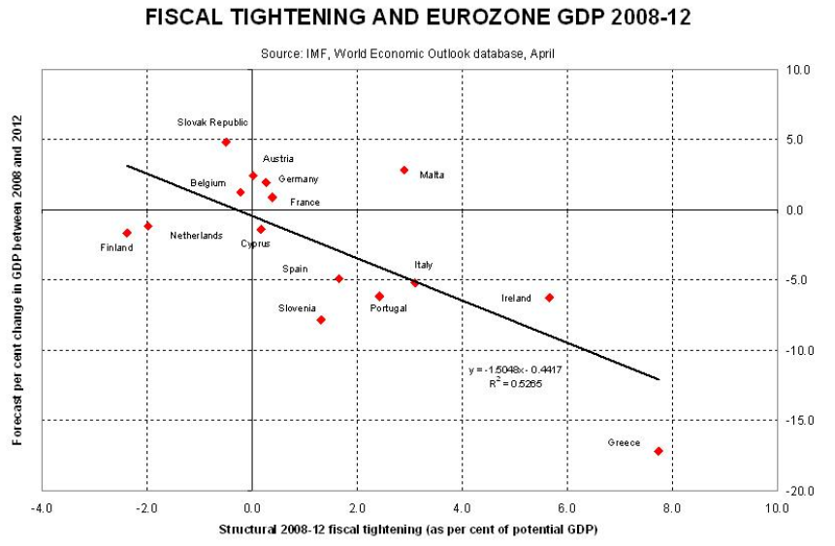
Source: FT

Slide 6
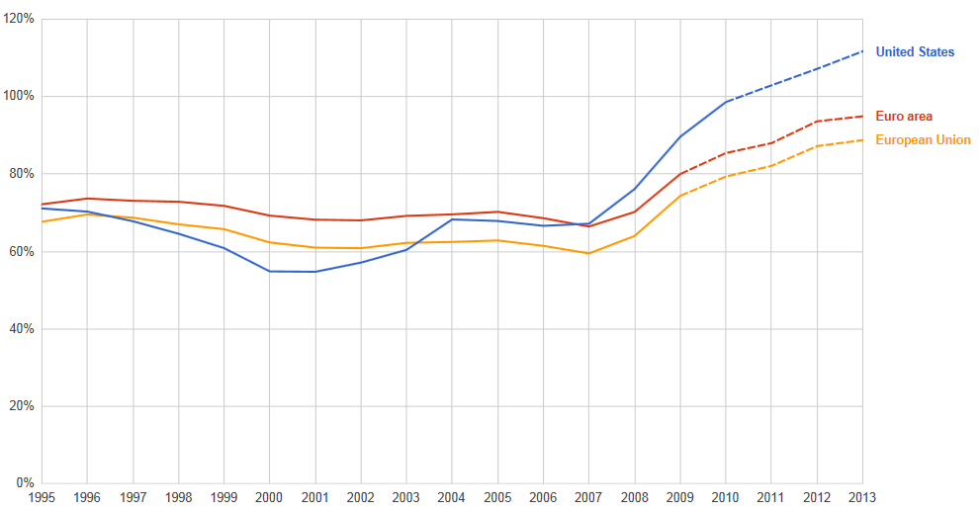
General government gross debt (% of GDP)
Source: IMF

Slide 7
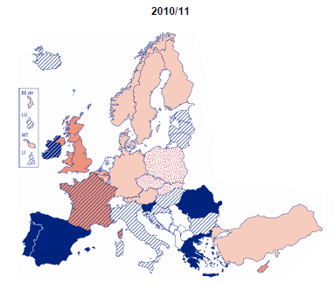
Evolution of teachers' and school heads' salaries (absolute terms compared with the previous year 2010/2011)
Source: Eurydice

Slide 8
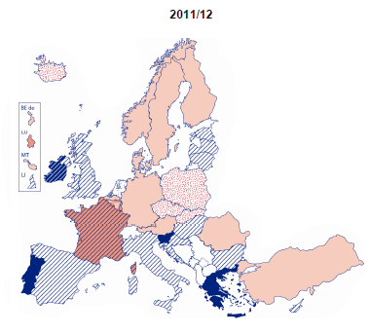
Evolution of teachers' and school heads' salaries (absolute terms compared with the previous year 2011/2012)
Source: Eurydice

Slide 9
ETUCE Action and Campaign Framework on the Financial and Economic Crisis (Survey)
55 teacher trade unions’ responses from 26 EU and 14 non-EU countries between February and March 2012.

Slide 10
Survey on the impact of the economic crisis on teacher education
31 teacher trade unions’ responses from 15 EU and 2 non-EU countries between June and July 2012

Slide 11
European economic governance: towards a new Treaty?
(adopted June 2010) Europe 2020: “European Semester” six-month period coordinating EU Member States’ structural, macro-economic and budgetary policy.
(March 2011) Euro Plus Pact: 23 EU Member States’ political agreement, including non-Euro Area countries (Bulgaria, Denmark, Latvia, Lithuania, Poland and Romania). “review of wage setting arrangements” is strongly opposed by ETUC.
(December 2011): Six Pack :Five new regulations and one directive boosted EU economic and fiscal governance (Six Pack).
(November 2011) Two Pack: macroeconomic surveillance.

Slide 12
European economic governance: towards a new Treaty?
(March 2012) Treaty on Stability, Coordination and Governance (TSCG): intergovernmental agreement, EU25
European Court of Justice (Article 8) to impose financial sanctions for failing to enshrine strict debt and deficit rules in permanent national (“preferably constitutional”) provisions.
“detailed description of the structural reforms” which ensure the correction of its excessive deficit.
A new treaty? Article 16 TSCG: “Within five years, at most”, of the TSCG’s entry into force, “necessary steps shall be taken … with the aim of incorporating the substance of this Treaty [TSCG] into the legal framework of the European Union.”

Slide 13
Pooling of sovereignty
Angela Merkel, German Chancellor:
"My vision is political union, because Europe has to follow its own path."
“Transfer more powers to the Commission which will then work as a European government.”
"This implies a strong parliament. The Council, which brings together heads of government, will form the second chamber. Finally, we have the European Court of Justice as the supreme court. This could be the future shape of the European political union in a while and, as I said, after many steps."
(January 2012 interview with six newspapers)
Olli Rehn, Commissioner Economic and Monetary Affairs:
December 2012 report by on the deepening of the EMU “will also examine what can be done within the current Treaty framework and which measures would require Treaty changes”
(September 2012 ECON Committee speech)
José Manuel Durão Barroso, President of the European Commission:
“We will need to move towards a federation of nation states. This is what we need. This is our political horizon.”
(2012 State of the Union Address)

Slide 14
Today’s excessive leverage: another crisis in the making?
European banks’ loans exceeded deposits by €1.3tn in 2011.
The notional value of the worldwide derivatives market is a mind-boggling 1,000 times $1.2tn ($1.2 quadrillion), roughly 20 times the size of world economy.

Slide 15
Measures for a new economy
The European Central Bank must explore every policy alternative within its mandate to bring down sovereign borrowing costs to a sustainable level.
European-level policymakers and national governments shall:
Advance strong growth and employment initiatives – which necessitate increased investment in education – to boost the European economy.
Reverse the policy of deflationary wage cuts as an instrument of fiscal adjustment.
Dismantle tax havens, tackle tax fraud and evasion, engage in deeper coordination of tax policies across Europe to strengthen tax revenue and to enhance fiscal contributions.

Slide 16
Measures for a new economy
Harmonise the corporate tax base across Europe, set a minimum tax rate for businesses, and adopt fair and effective progressive tax systems to obtain additional revenue for education budgets.
Adopt a Europe-wide financial transaction tax.
Advance effective Europe-wide regulatory and supervisory framework to tackle regulatory arbitrage and provide for transparent central clearance of over-the-counter (OTC) derivatives, sound macro-prudential analysis, and the harmonisation of capital and liquidity requirements while curbing excessive risk-taking.
Advance the issuance of jointly-backed Eurobonds as an instrument of debt solidarity with a view to decreasing interest rates on sovereign debt.

Slide 17
Measures for a new economy
Adopt a framework for the allocation of unused structural funds to support sustainable investment, including investment in education.
Tackle corruption and engage in corporate governance reform which boosts transparency and accountability standards as well as democratic participation.
Prevent the privatisation and commercialisation of education services, support national social dialogue structures, trade union rights, social cohesion, and solidarity among generations.

Slide 18
A new Treaty ? Alternative ways ?
Exit the Crisis with solidarity
Thank you for your attention.
www.csee-etuce.org

