Slide 1
Educate, Engage & Grow Lessons in Member Engagement
EI ComNet
Michael Misterek
National Education Association
Notes:
Students-centered
Does it help students and your members?
Do your members recognize the value of your work?
Does it help your association grow?
- membership
- internal organization and engagement efforts
Diversity of job titles
Gender, racial, age
Key media markets and geographies
Keeping a healthy speaker’s bureau is a numbers game.
There were a number of pay offs for this work.
We had pre-trained members at the ready to push into the media narrative.
We had members to offer the campaign as surrogates when they needed them.
We were able to make all of our deliverables (paid creative products) more authentic because we had captured so much material from the trainings.
Lesson Learned:
We learned that a speakers’ bureau is really a living, breathing thing. We had to stay in touch with these members, and continually recruit, train, and communicate with them.

Slide 2
Goals for Member Engagement
Know Where to Find Your Members
Use Data & Always Analyze
Always Aim to Educate
Play to Your Strengths
Be Ambitious – Embrace the Unknown
Notes:
Educate, engage and grow
Find: your audience. Go to them. Force them to engage in your campaign.
Use your data and be vigilant about collecting and analyzing ongoing
Educate -- Make sure you use every campaign to push your agenda and show your value and strength as an organization.
Don’t try to do everything, and know what angles will work for you.
Continue with what works but embrace the new. More sophisticated tools, and more sophisticated use of the tools.

Slide 3
Every Student Succeeds Act (aka the end of No Child Left Behind)
Challenges
Breaking through with decision makers
Educating and engaging our members
Sustaining momentum
Notes:
Competing interests all over the place, and the US Congress is not known for passing major legislation
Our members care, but sometimes they aren’t aware what they should care about and why. It takes several touches to get their attention.
The US Congress has an attention span on par with my 1 year old daughter,

Slide 4
Using Digital to Win
Match members on Pinterest, Instagram, Twitter and Facebook
Geo-Targeting policymakers, staff, media, opinion leaders
Match with tried and true tactics
“Tweet Your Rep” tool
Notes:
It had been 14 years since it passed, and several failed attempts to finally rewrite the law.
We used many tried and true methods, email communications, & earned media but we need to move beyond these to break through and have an impact.
Google search
Cookie
To use our resources wisely and in an effort to
Deliver a message directly to our audience based on ZIP Code, organization and building IP address,
List match
36% of our emails matched, approx. $.40 per match
We needed to find a way to use limited resources to drive advocacy.
Emails your members
Mobile – one touch click to call

Slide 5
ESSA Results
Nearly 300,000 emails into targeted members of Congress.
Over 25,000 phone calls made
40,000 tweets to targeted members of Congress
Notes:
Engage, Educate members and Analyze results
Measured results – National Journal
Award winning campaign to replace No Child Left Behind

Slide 6
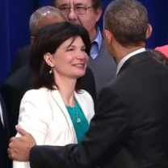
Every Student Succeeds Act

Slide 7
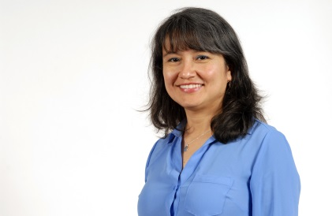
Educators are considered one of the most effective messengers in their communities. When they talk, people listen.
Notes:
Public school teachers and other educators who work in schools and classrooms have been near the top of the list of America’s most admired spokespersons for decades, and according to the Harris polling firm, teachers are one of the “most admired professions.”
• Educators are considered one of the most effective messengers in their communities and when they talk, their communities listen.
• Whether it’s an issue campaign or a candidate running for office at the local, state or federal level, educators are active in getting out the vote. educators have the power to effect real change and shape outcomes.

Slide 8
Member Voices
Prepare for rapid response media work
Offer rank-and-file campaign surrogates
Help with event turnout/Bird-dogging
Inspire independent activism and leadership
Create a digital echo chamber
Notes:
Knowing that our members are our greatest asset, we developed the NEA Member Voices Program. Over the last two years, we trained hundreds of spokespersons from all over the country. We brought members to DC, we went out to the states and we did individual webinars.
We needed to find a way to use limited resources to drive advocacy

Slide 9
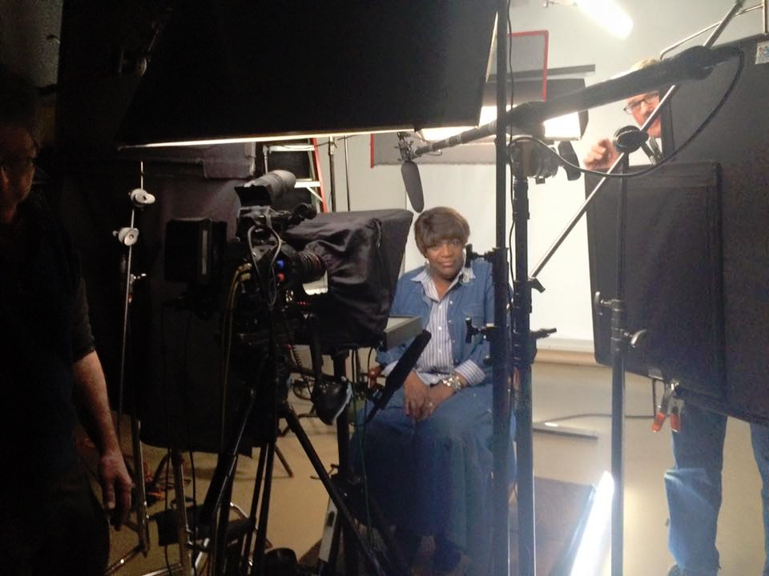
Notes:
Training curriculum
Media skills
Activism skills – New Hampshire practiced bird dogging
Message Skills
Establish relationship
Generate Creative Assets
We take advantage of every opportunity with educators, we filmed them, with took photos, we interviewed them. We collected their social media information.

Slide 10
Using Video in Digital
Notes:
Used members to persuade and engage
Test: the Analyst Institute who determined that the “recall” of these ads among their target audience was the highest they’d ever seen. The ads effectively persuaded members to support Hillary in the primary and were particularly effective among millennial members.
One important lesson we learned in with these videos is that it’s incredibly hard to push programs like these virally through Facebook anymore. We had to put serious dollars behind the videos as paid content before they were seen by our targets.

Slide 11
The Trump Effect
“Nation’s largest labor union plans to link Trump to rise in school bullying”
A national phenomenon has become local – social-studies teachers across Iowa are having trouble navigating the political discourse when covering the current election in their classrooms.
-The Daily Iowan
Notes:
Find where your voice is most impactful:
In the final 5 weeks of the campaign: 100 media inquiries. Half of them were national, and half were state-based requests
USA Today, Washington Post, NYTimes, national TV, etc.
Now using for school climate, response to Sec of Education, etc.

Slide 12
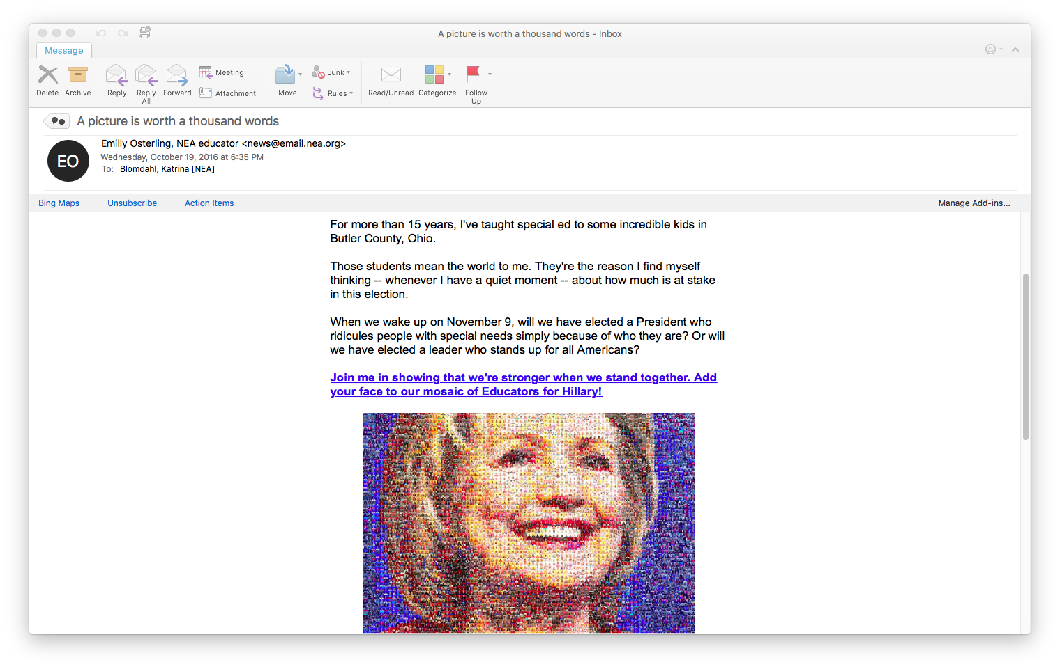
Notes:
What worked:
Localize and personalize it
Use visuals, be short and to the point. Do not write a novel before your first ask. 150 words.
Opportunities
Experimentation: Always test -- We have a large enough community to do not just short-term tests around tactics and messaging, but long-term testing

Slide 13
2016 Presidential Results
Over 100 earned media hits – national and state
Media and influencers recognized our impact
NEA members voted at a higher rate for Clinton than Obama

Slide 14
What’s Next?
Analyze the results
Re-engage members in campaigns that best suit them
Invest in what works
Growth
Notes:
School climate
DeVos
Choice
Civil rights

