Slide 1
Linking global education reforms to what’s happening in education systems nationally
ComNet, June 2013
Notes:
Good morning everyone, this morning I would like to illustrate what Charlie has said – show how global ed reforms are closely linked to education developments at the national level. Together with my colleague Jeff we will set the scene for the discussion of the next two days around the Mobilising for Quality Education Campaign
In today’s globalised world we see the increased borrowing and lending of education reforms and policies
Harmonisation/homogenisation of policies
Shifting consensus about role & purpose of education

Slide 2
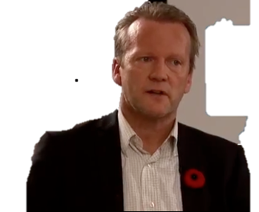
GLOBAL EDUCATION REFORM MOVEMENT
Notes:
These global patterns are what Finnish Education activist, Pasi Sahlberg, terms the Global Education Reform Movement
In today’s globalised world we see countries around the world implementing education policies that look increasingly similar to one another
Harmonisation/homogenisation of policies
Shifting consensus about quality education from inputs (investing in schools and teachers) to learning outcomes

Slide 3
GLOBAL EDUCATION REFORM MOVEMENT
Notes:
The first letters of these words cleverly forms the word

Slide 4
GERM
Notes:
Sahlberg argues that the Global Education Reform Movement is like a virus that travelling with politicians, policy makers, global institutions, consultants and is infecting our education systems. It can be referred to as an ‘epidemic’ of education reforms that are harmful to our teachers, schools and education systems.

Slide 5
GERM symptoms
Competition
Choice
Standardisation
Test-based accountability
Notes:
So what is happening globally and how can detect a GERM? In countries around the world we see the following symptoms:
Schools are encouraged to compete with each other for students and funding – the assumption is that if they compete, they will perform better, what this means is that schools are no longer cooperating or working together. Teachers are also encouraged to compete against one another through performance evaluation. It is assumed this will improve education quality, because parents will not choose to send their children to under-performing schools.
Choice is promoted as a good thing – Households are set up as consumers who can choose the best school for their children – which is the school with the best results. Increasing numbers of charter schools in the United States, secondary school academies in England, free schools in Sweden and private schools in Australia are examples of expanding school choice policies. LFP private schools promote choice. Leads segregation of students into those who can access schools
Standardised tests are increasing used to evaluate how well schools are performing, and at the national level how education systems are performing
Test-based accountability –shift of the focus of attention in education to learning outcomes. The assumption is that setting high performance standards for schools, teachers and students will necessarily improve the quality of education and outcomes. Curricula are standardised to meet test requirements and narrowed to focus on the measurement of core subjects.
Teachers are increasingly being evaluated in terms of their student performance and are schools and teachers are held accountable for student outcomes, which in a context of choice and competition is detrimental for schools, performance-based pay

Slide 6
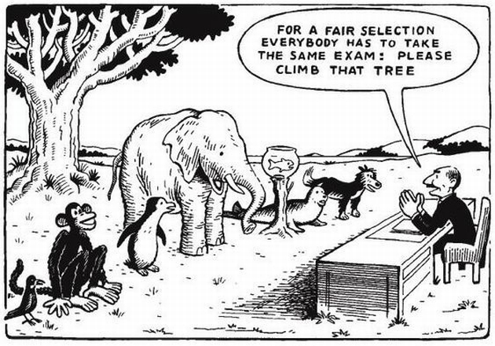
Notes:
Classroom where students are all very different with diverging talents, but with a standardised procedure you cannot expect that children will do the same, you set some students up for failure, and we can look at the goldfish

Slide 7
Who’s spreading the GERM?
Notes:
Proponents of the GERM make it clear who is to blame for failing school systems and children: World Bank cover of a sleeping teacher… the World Bank has responded with what it calls SABER-teachers to help shape education frameworks and policies aims at teachers in national education systems, drawn up by a group of economists and notably without the consultation of teachers or their unions – but more on that later from Jeff.
And corporations, small and large businesses, aid agencies, education consultants (McKinsey), philanthropists (Bill and Melinda Gates foundation) are ‘profiting’ (literally) from these developments big time by getting involved in education service delivery and policy development: think of DfID funded low fee private schools, PEARSON and high stakes standardized tests for students and teachers which are sold to states in the US, World Bank accountability and benchmarking for teachers through SABER teachers, World Bank Education Strategy not focused on equity

Slide 8
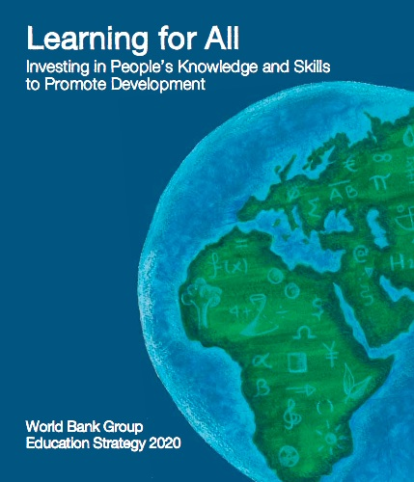
Notes:
The World Bank – a quick look at education projects funded in by the World Bank, and regional development banks in recent decades, shows how school competition, decentralisation, private sector participation and more recently, accountability have been disemminated to all regions.
World Bank cover of a sleeping teacher… the World Bank has responded with what it calls SABER-teachers to help shape education frameworks and policies aims at teachers in national education systems, drawn up by a group of economists and notably without the consultation of teachers or their unions – but more on that later from Jeff.

Slide 9
Notes:
OECD:
We see that international standardized tests like PISA are becoming global curriculum standards. Indeed, OECD has observed that its PISA test is already playing an important role in national policy making and education reforms in many countries. Schools, teachers and students are now prepared in advance to take these tests. Learning materials are adjusted to fit to the style of these assessments. Life in many schools around the world is becoming split into important academic study that these tests measure, and other ‘not-so-important’ study that these measurements don’t cover. This is kind of a GERM in large scale.
PISA – Sweden, Norway, New Zealand, Canada, US. PISA for development, but although tests such as TIMMS are also used in other countries

Slide 10
Notes:
Pearson – e.g. funds chains of low fee private schools in Ghana through their ‘affordable education fund’ but also sells off standardised tests to states in the US

Slide 11
Notes:
DFID (UK’s department for International development) is supporting the World Bank's "Education Markets" study of low fee private schools carried out by Harry Patrinos of the World Bank
And the list goes on: Brookings, PREAL in Latin America, regional development banks and agencies, small and large corporations, consultants, politicians, policy makers, private intellectuals (Tooley, Patrinos)
Paul Vallas – proponent private school systems & suspend teacher contracts (New Orleans, Haiti, Chile, New Zealand)

Slide 12
What are (some of) the effects?
Increased privatisation
High stakes testing: Narrowed curricula, test-based evaluations, teaching to the test
Increased inequities
Teachers’ deprofessionalisation: Reduced pedagogical autonomy, performance-based pay, contractualised labour
Notes:
So competition, choice, standardised testing and accountability
Private schools as the alternative to public schools – more choice
Charter schools that we have seen in the UK, Sweden, US, New Zealand
Low fee private schools: India, Pakistan, Afghanistan, Kenya, Nigeria, Ghana
Public private partnerships
Narrowing of curricula – PISA as criteria of good educational performance – reading, maths and science ‘literacy’ have become the main determinants of success of students, teachers, schools and whole education systems. Standardized testing has increased teaching to the test, narrowed curricula to prioritize reading and mathematics
Poor families are not able to access private schools

Slide 13
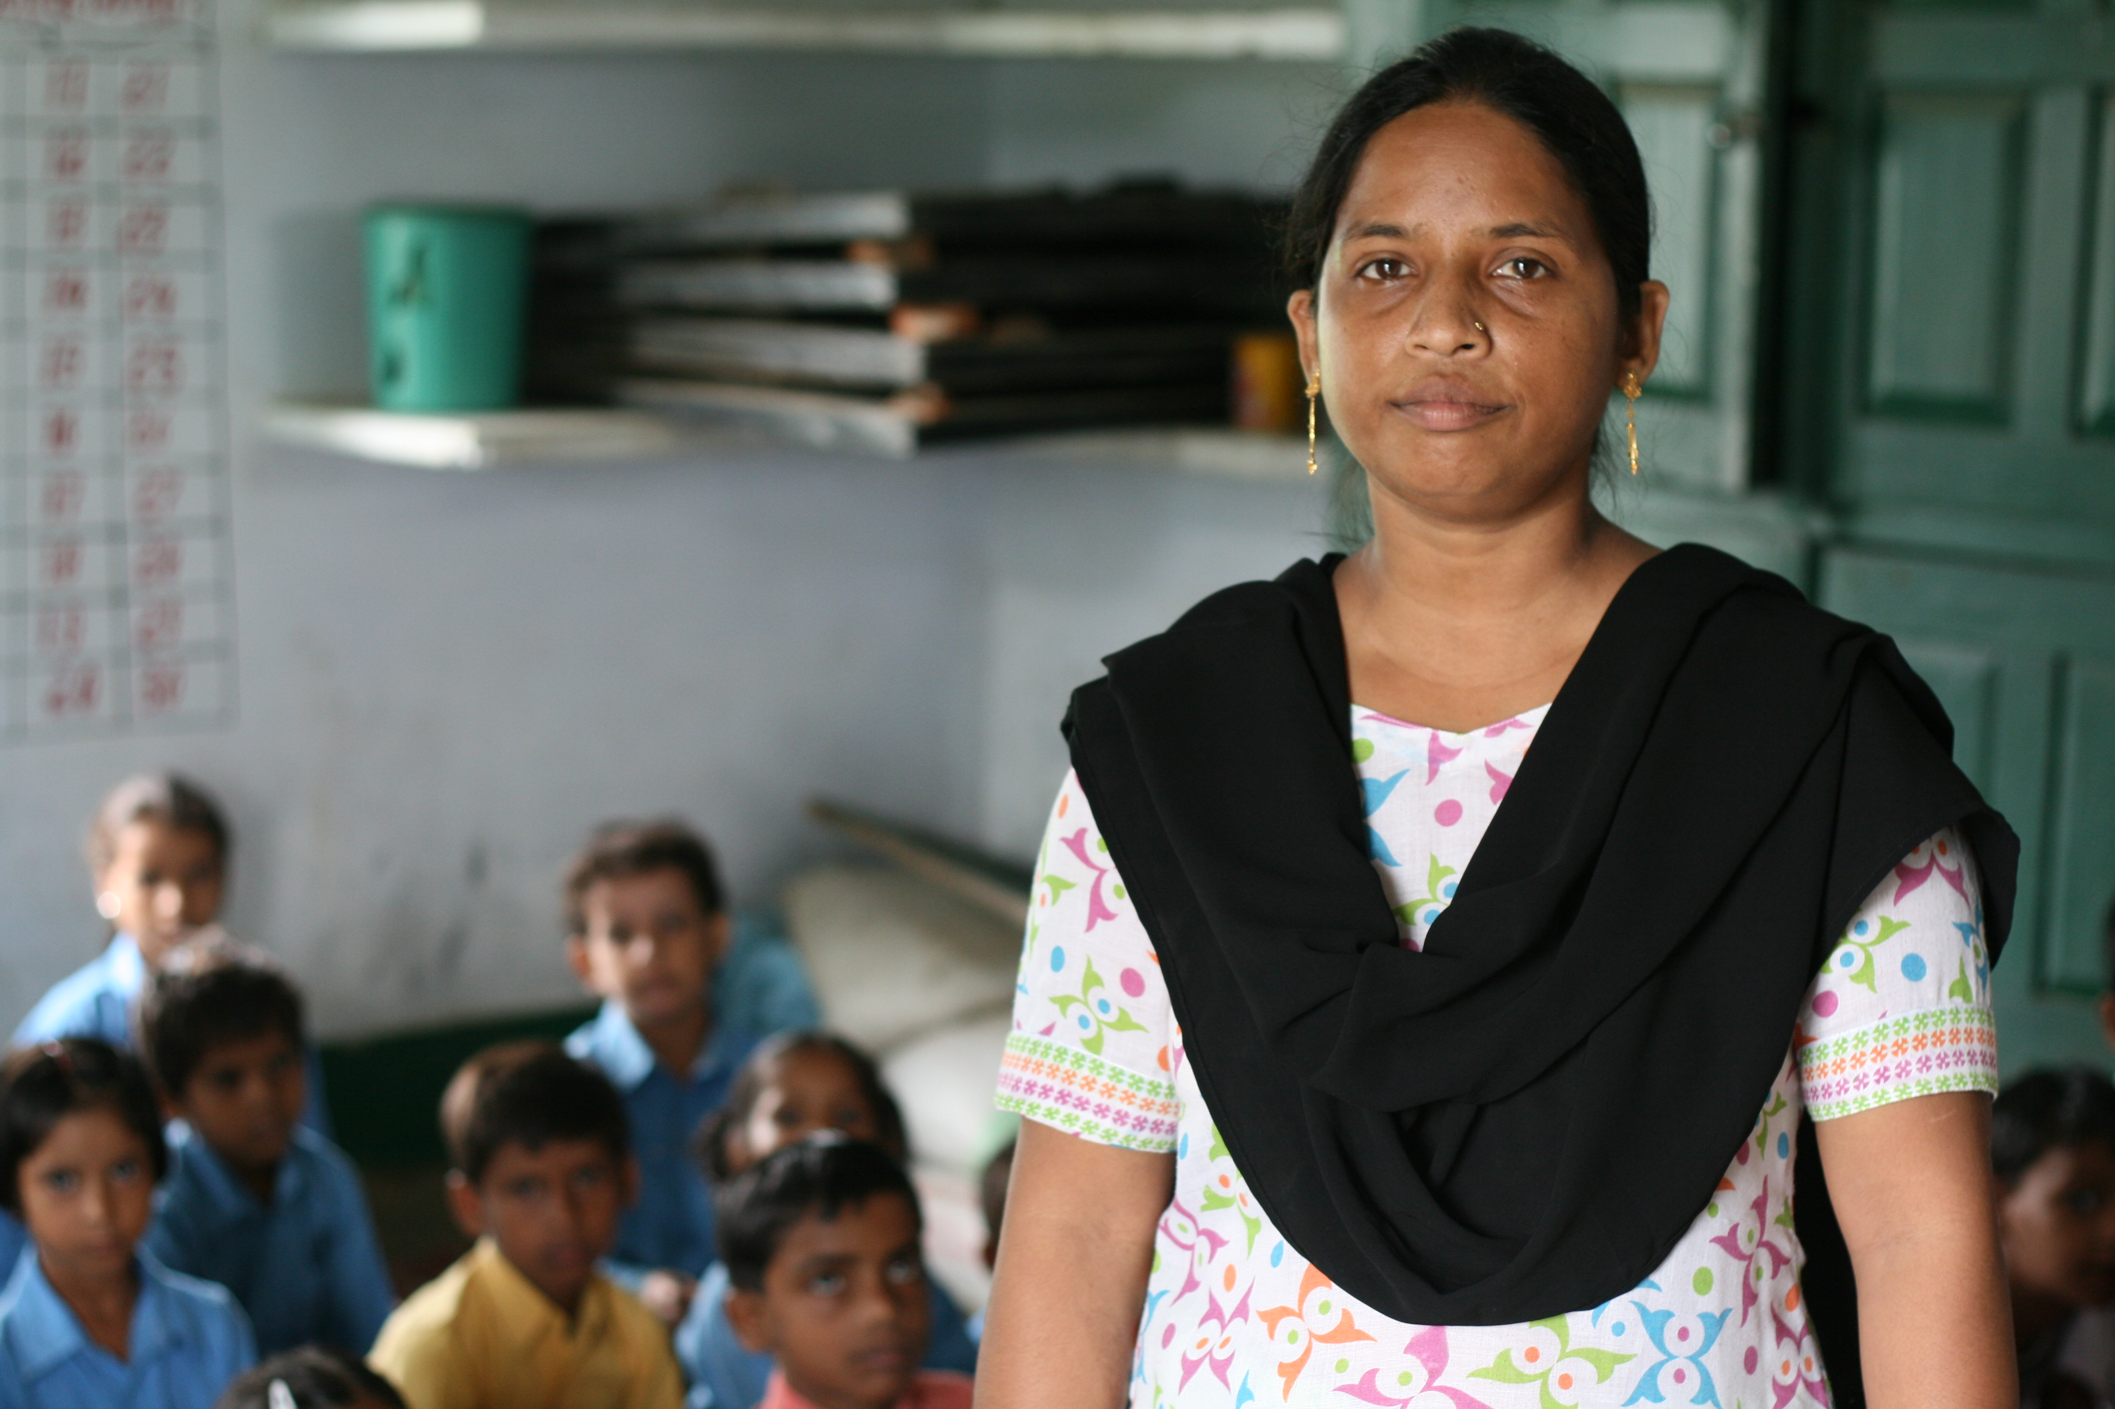
[One example of each: photo: teacher in India]
Notes:
I want share a story with you that some of you will be familiar with This is … She’s a teacher working in a rural school in the state of Uttar Pradesh in India. I met her in 2010. […] works on a contract and earns a tenth of the salary of her colleagues working in the same school as her. She’d been working at that primary school for … years.

Slide 14
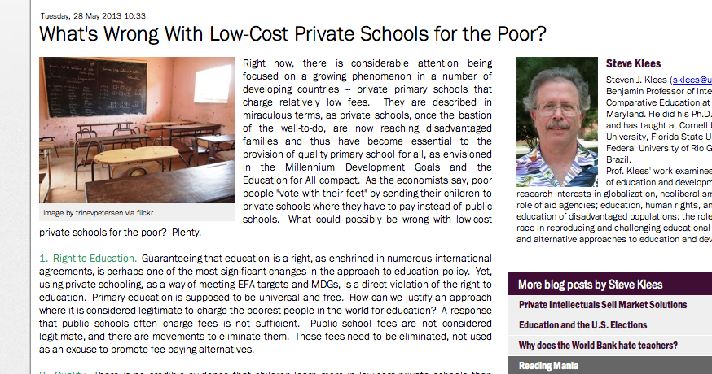
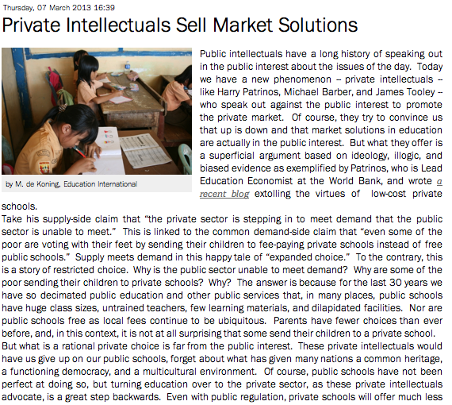
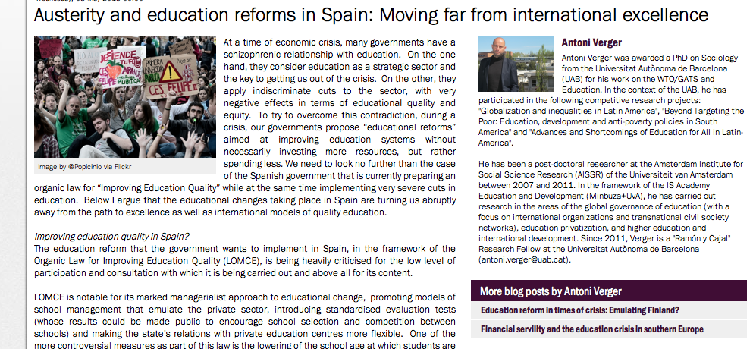
Notes:
We are carrying out the analysis – through studies and our Education in Crisis website
Steve Klees blog posts, Stephen Ball cover, NZ campaign, van Roekel WB speech, Global Managerial Education reforms]

Slide 15
Notes:
We are carrying out the analysis – through studies and our Education in Crisis website
Steve Klees blog posts, Stephen Ball cover, NZ campaign, van Roekel WB speech, Global Managerial Education reforms]

Slide 16
Notes:
We are carrying out the analysis – through studies and our Education in Crisis website
New Zealand colleagues imposition of charter schools, performance-based pay for teachers, national league tables for primary schools and ''super boards'' which would govern several schools.

Slide 17
What happens globally impacts locally
Notes:
Two main messages that we can draw from
In countries affected by austerities, GERM policies will sound good to politicians and policy makers seeking to cut public investments
Part of a bigger story

Slide 18
What’s happening at home is likely also happening elsewhere and vice-versa
Notes:
What’s happening elsewhere is likely also happening at home and What’s happening at home is likely also happening elsewhere
In countries affected by austerities, GERM policies will sound good to politicians and policy makers seeking to cut public investments
Part of a bigger story
If we want to take on the GERM we need to articulate stories of what’s happening around the world, being informed about what’s happening globally and locally impact each other

