Slide 1
HUMAN RIGHTS AND VALUES
IN EDUCATION
Sneh Aurora
Human Rights Education Consultant
Education International
Riga, June 2016

Slide 2
BACKGROUND PAPER
PART ONE:
what we mean by human rights education
the legal basis for human rights education
PART TWO:
the implications and application of human rights education or a rights based approach to education

Slide 3
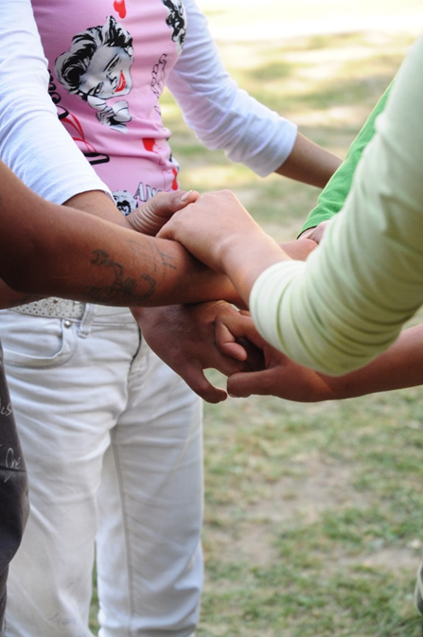
HUMAN RIGHTS EDUCATION
Human rights education is vital to develop a culture of human rights and a society that embraces dignity, inclusion, and equality

Slide 4
HUMAN RIGHTS EDUCATION
The full realisation of human rights requires all human beings to be aware of their and other people’s rights and of the means to ensure their protection. This is the task of human rights education which builds knowledge, skills and attitudes prompting behavior that upholds human rights.
Navi Pillay, former UN High Commissioner for Human Rights

Slide 5
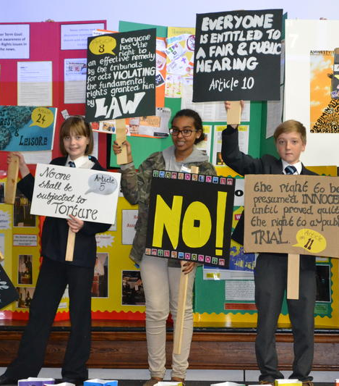
HUMAN RIGHTS EDUCATION
Human rights education is a lifelong learning process
aimed at fostering:
Knowledge and skills
Values and attitudes
Behaviour and action

Slide 6
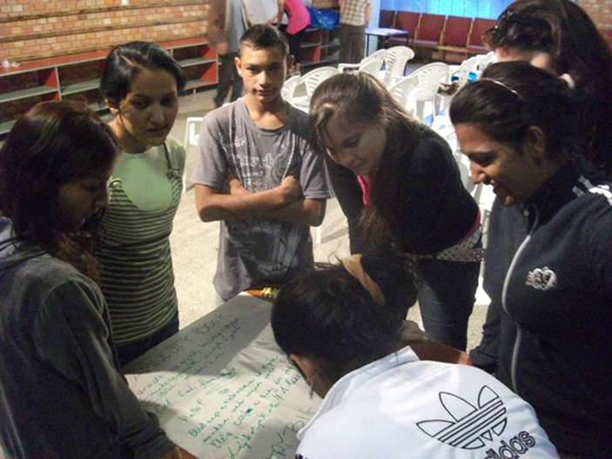
HUMAN RIGHTS EDUCATION
….IS EDUCATION
…about human rights
…through human rights
…for human rights

Slide 7
REAFFIRMING THE IMPORTANCE OF HUMAN RIGHTS EDUCATION
UN Sustainable Development Goals (Goal 4.7)
World Conference on Human Rights (1993)
UN Decade for Human Rights Education (1995-2004)
World Programme for Human Rights Education (2004- )
Global Education First Initiative (GEFI) (2012)

Slide 8
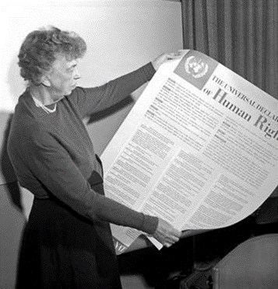
HUMAN RIGHTS EDUCATION IN INTERNATIONAL LAW
Every individual and every organ of society … shall strive by teaching and education to promote respect for these rights and freedoms.
Preamble to the Universal Declaration of Human Rights (1948)

Slide 9
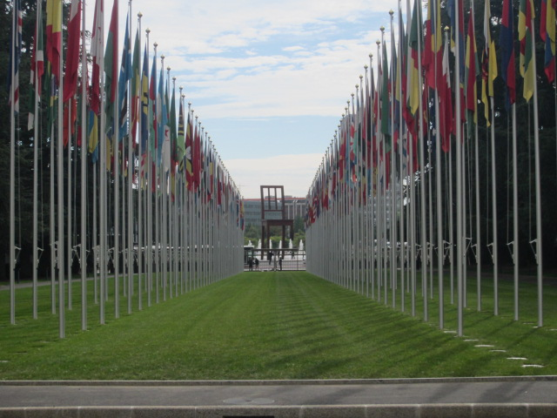
UN DECLARATION ON HUMAN RIGHTS EDUCATION AND TRAINING
Everyone has the right to know, seek and receive information about all human rights and fundamental freedoms and should have access to human rights education and training
Human rights education and training is essential for the promotion of universal respect for and observance of all human rights and fundamental freedoms for all

Slide 10
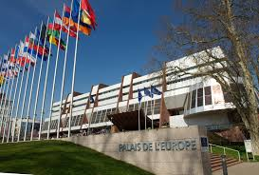
HUMAN RIGHTS EDUCATION IN EUROPE
The Charter on Education for Democratic Citizenship and Human Rights Education

Slide 11




HUMAN RIGHTS EDUCATION IN EUROPE

Slide 12
RIGHTS BASED APPROACH
Universality and Inalienability
Indivisibility
Interdependence and Interrelatedness
Equality and Non-discrimination
Participation and Inclusion
Empowerment
Accountability and Respect for the Rule of Law

Slide 13
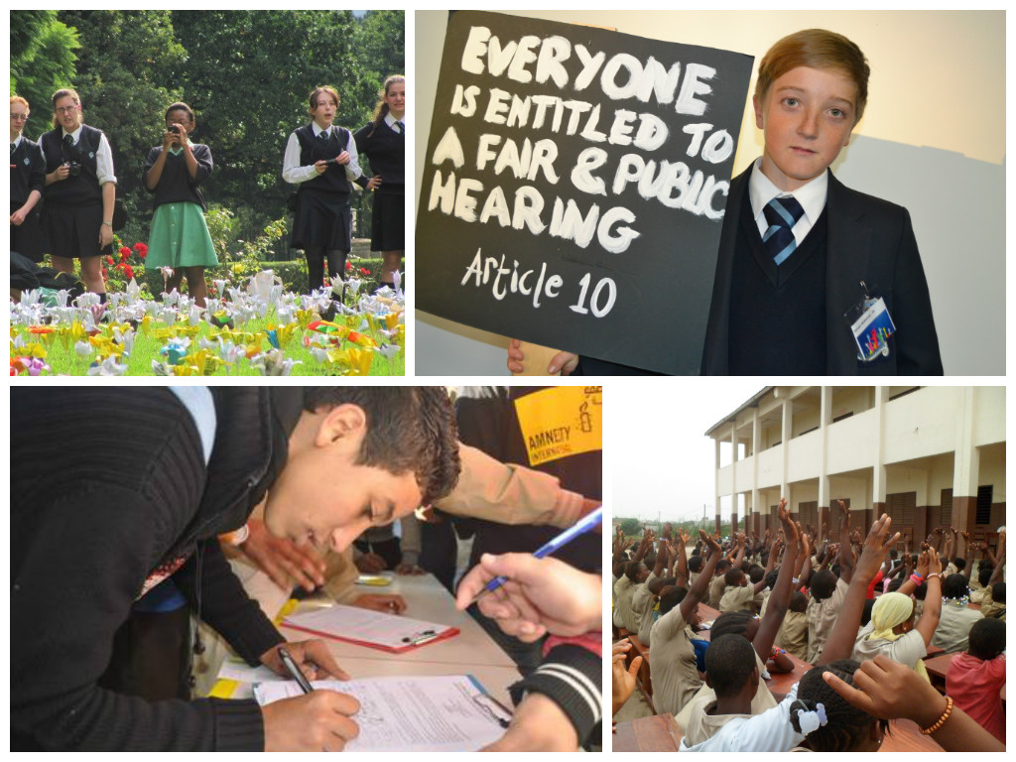
A RIGHTS BASED APPROACH TO EDUCATION
social cohesion, integration and stability
peace and non-violent conflict resolution
positive social transformation
economic development

Slide 14
RIGHTS BASED APPROACH TO EDUCATION IN PRACTICE
Teacher training, professional development and support

Slide 15
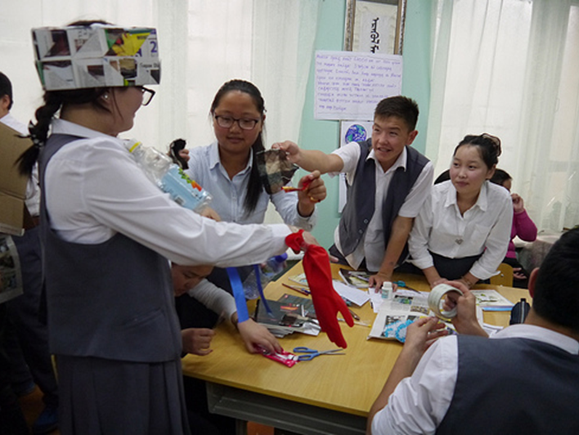
RIGHTS BASED APPROACH TO EDUCATION IN PRACTICE
Teaching and learning practices and processes

Slide 16
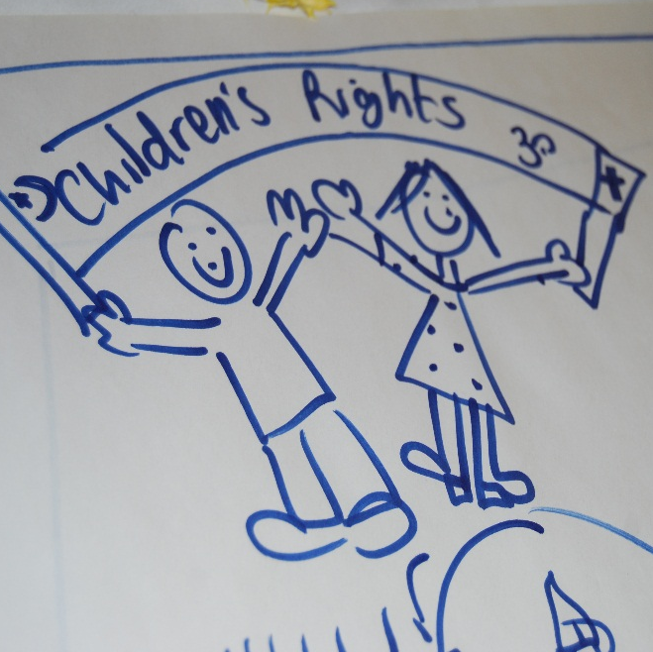
RIGHTS BASED APPROACH TO EDUCATION IN PRACTICE
An inclusive curriculum

Slide 17
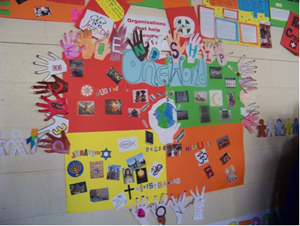
RIGHTS BASED APPROACH TO EDUCATION IN PRACTICE
A whole school approach to human rights

